Slide 1

Green Your Business at the University of East London

Slide 2
Prof Darryl John Newport –
Director of the Sustainability Research Institute

Slide 3
Agenda:
10:30: Welcome and introductions - Prof Darryl John Newport - Director, Sustainability Research Institute, University of East London
10:35: Introduction to the ARENA Project - Dr Mike Medas - Senior Research Project Manager, ARENA Project
10:45: Developing soil moisturising technology with the support of the ARENA project - Meena Joshi – Director, AARDRA Systems
10:55: Supporting sustainable businesses in London’s Royal Docks - Duncan Boak - Business Centre Manager, University of East London
11:10: Migrating towards a greener culture in e-commerce - Tom Brennan - Business and Marketing Director, St Johns Laboratory
11:20: Developing an inclusive green tech business community in the Royal Docks - Matt Davies - Head of Economic Development, Royal Docks Enterprise Zone
11:30 - Q&A Panel Discussion
12:00 - Close

Slide 4
Dr Mike Medas –
Senior Research Project Manager, ARENA Project

Slide 5



The ARENA project –
Support available on the circular economy
and nature-based solutions
8 June 2021
Dr Mike Medas
Senior Research Project Manager (ARENA)
Sustainability Research Institute
University of East London
https://www.uel.ac.uk/sri
https://www.uel.ac.uk/sri/arena

Slide 6
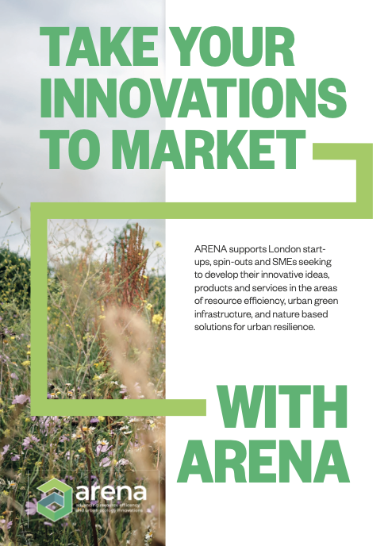
Our clients
New and existing businesses, seeking to develop innovative ideas in the following areas:
Resource efficiency and the circular economy
Urban green infrastructure and nature-based solutions for urban resilience
Who we are
The Sustainability Research Institute (SRI) is UEL's centre of excellence for environmental research and development. We collaborate with industry, government, public agencies and charities to enable changes in physical infrastructure and social capital that benefits the environment, promotes sustainable living and creates a carbon neutral society.
Notes:
To replace with a photo of your own: 1) Send the geometric shape overlay to the back – Right-Click > Send to Back > Send to Back. 2) Replace image – use the guides provided to correctly position it. 3) Send your image to the back so that the geometric overlay re-appears over the image.

Slide 7
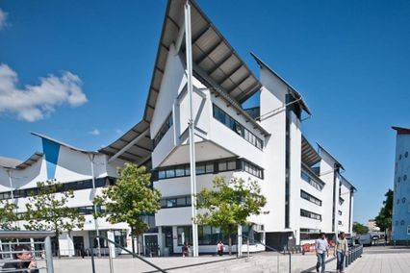
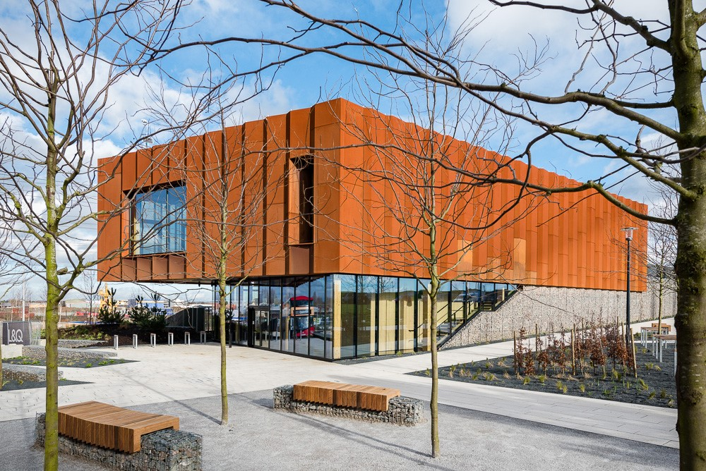
The ARENA offer
Market knowledge and networks
  Support to enhance the commercial validation of innovations to increase their market deployment and uptake
Research and development support
  In-lab research and technological validation for early stage innovation
Demonstration trials
  Pilots and performance assessment in a real world environment - the new Barking Riverside Ecology Centre
Promotion and showcasing
  Innovation publicity and promotion
Market rollout and promotion support
  Brokerage to private and public clients
Notes:
To replace with a photo of your own: 1) Send the geometric shape overlay to the back – Right-Click > Send to Back > Send to Back. 2) Replace image – use the guides provided to correctly position it. 3) Send your image to the back so that the geometric overlay re-appears over the image.

Slide 8
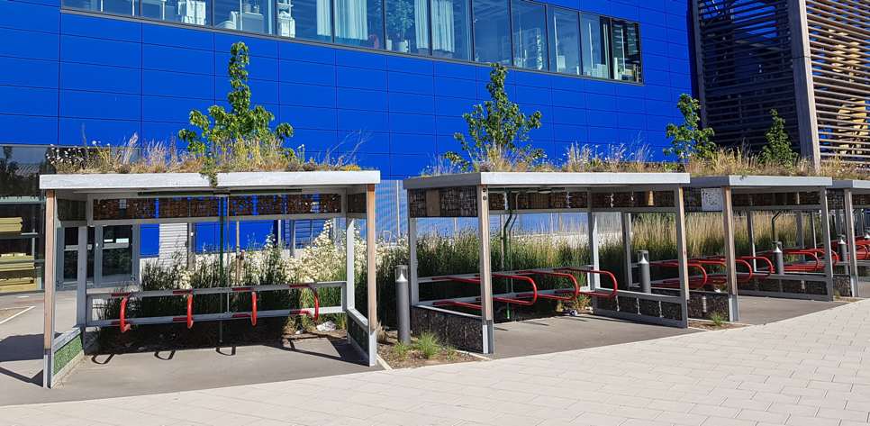
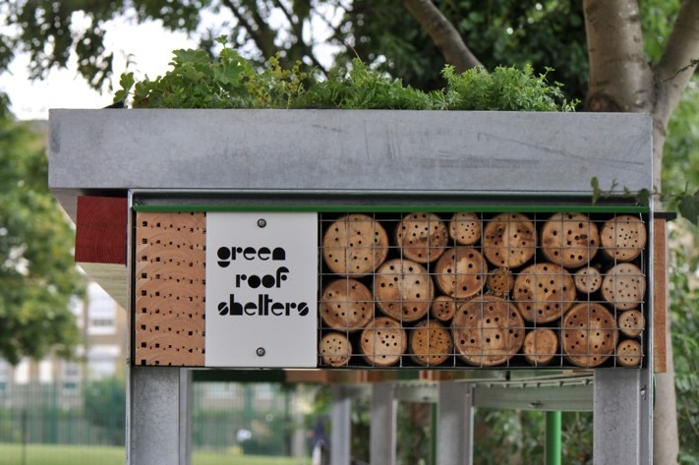
Case study – Green Roof Shelters
Adopting an ecomimicry process (mimicking locally typical habitats), Green Roof Shelters turn ordinary everyday infrastructure, like bin covers, bicycle shelters, and freight containers, into nature-based solutions capable of supporting biodiversity.
How ARENA was able to help
Providing ecological expertise into the design of new nature-based solution products;
Supporting development & adaptation of existing products to provide new habitats for wildlife not currently accommodated;
Monitoring installed Green Roof Shelter products in-situ to assess performance in terms of supporting biodiversity. This includes surveys of the wildflowers growing on the green roofs, insects that are making a home on the products, and birds that are using the bird boxes that are part of the green roof shelter design.
Notes:
To replace with a photo of your own: 1) Send the geometric shape overlay to the back – Right-Click > Send to Back > Send to Back. 2) Replace image – use the guides provided to correctly position it. 3) Send your image to the back so that the geometric overlay re-appears over the image.

Slide 9
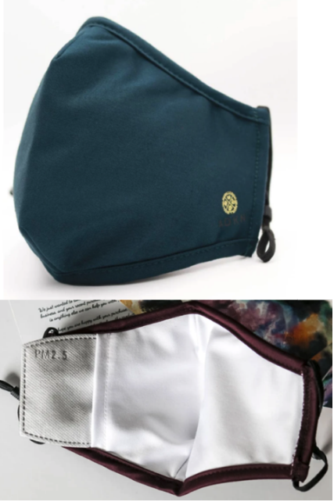
Case study – ADKN
ADKN is an animal-free, eco-friendly, sustainable and ethical fashion brand and garment manufacturer, based in England. ADKN has developed a 4 layered reusable face mask made from 100% organic materials including hydrophobic bamboo and Tencel.
However, in the absence of available regulation testing facilities or the specific and costly equipment required, there is a need to replicate regulatory guidelines with methods than can provide reliability and assurance.
Notes:
To replace with a photo of your own: 1) Send the geometric shape overlay to the back – Right-Click > Send to Back > Send to Back. 2) Replace image – use the guides provided to correctly position it. 3) Send your image to the back so that the geometric overlay re-appears over the image.

Slide 10
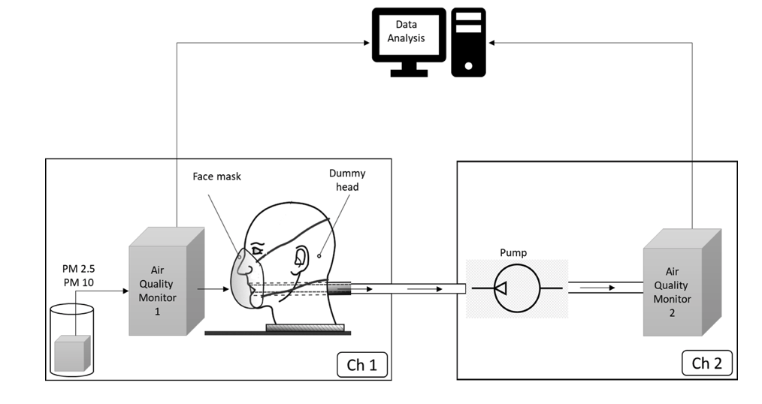
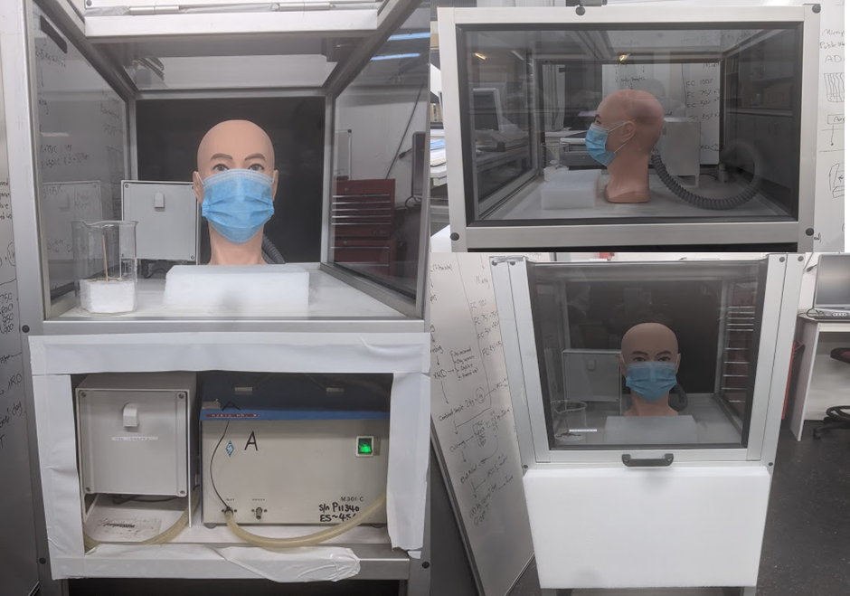
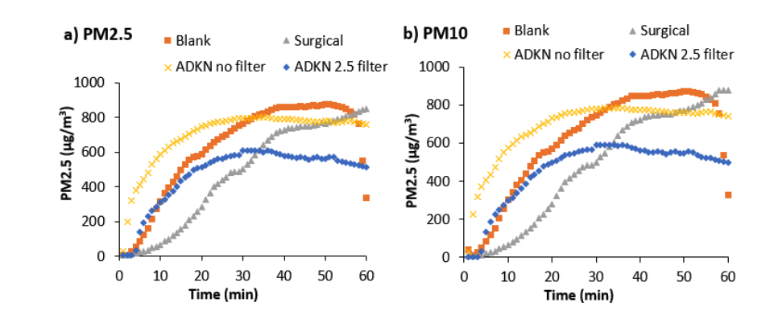
Case study – ADKN
How ARENA was able to help
We developed a low-cost and accurate method to quickly evaluate masks that could be replicated in communities lacking the infrastructure necessary for regulation tests. The method is designed to test face the filtering efficiency of masks
The results so far measure the filtering efficiency of masks for capturing particulate matter, both with and without a PM25 insert
Notes:
To replace with a photo of your own: 1) Send the geometric shape overlay to the back – Right-Click > Send to Back > Send to Back. 2) Replace image – use the guides provided to correctly position it. 3) Send your image to the back so that the geometric overlay re-appears over the image.

Slide 11
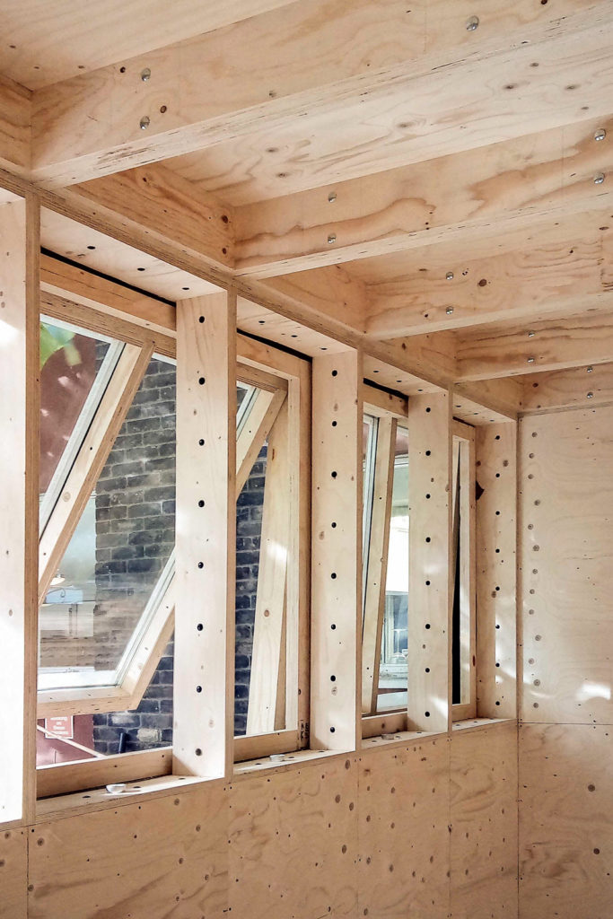
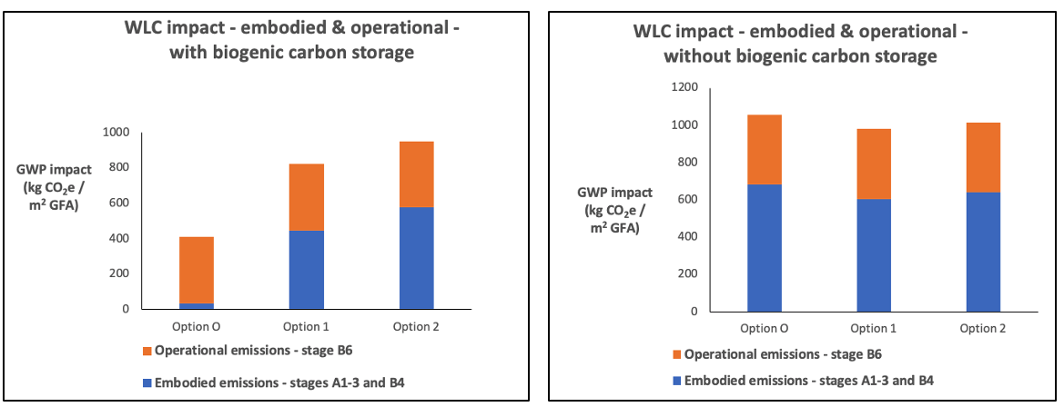
Case study – resource-efficient, circular design
Our client is an innovative architectural design practice that uses a circular economy approach to building, offering a revolutionary, flat-pack self-build system based on non-toxic natural materials.
A common challenge for built environment practitioners has been the difficulty of comparing GHG emissions for the ‘whole life’ rather than just the ‘operational life’ of alternative building designs.
How ARENA was able to help
Development of a bespoke, whole-life carbon analysis comparing the embodied and operational emissions of the proposed innovative design solution with a conventional alternative
Notes:
To replace with a photo of your own: 1) Send the geometric shape overlay to the back – Right-Click > Send to Back > Send to Back. 2) Replace image – use the guides provided to correctly position it. 3) Send your image to the back so that the geometric overlay re-appears over the image.

Slide 12
Dharmesh Joshi and Manorma Joisi –
AARDRA Systems

Slide 13


Slide 14
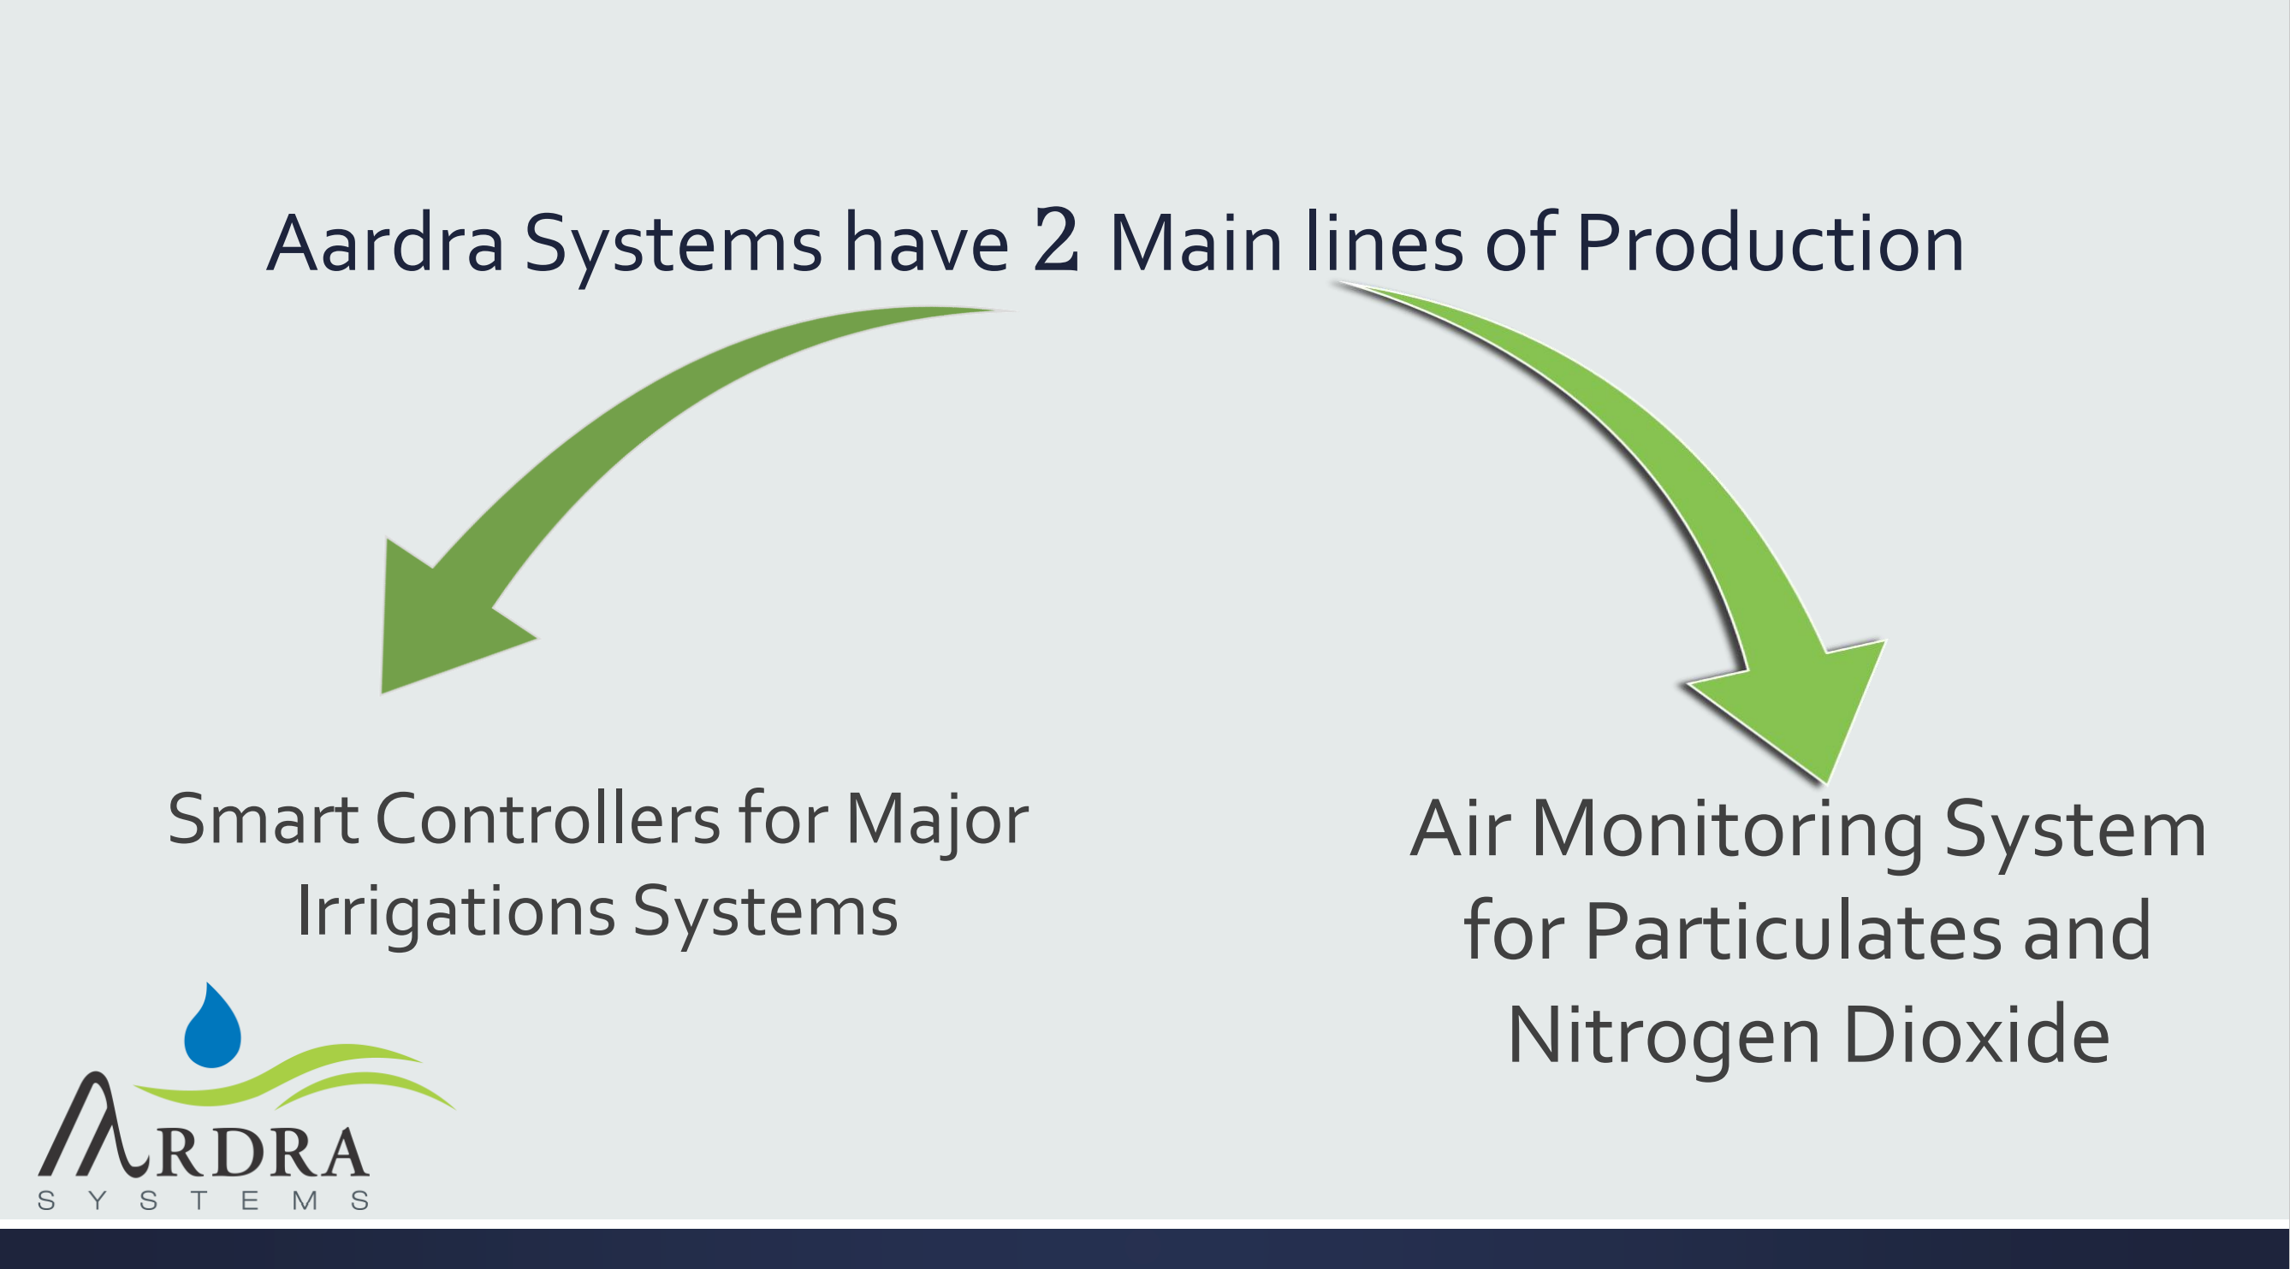

Slide 15
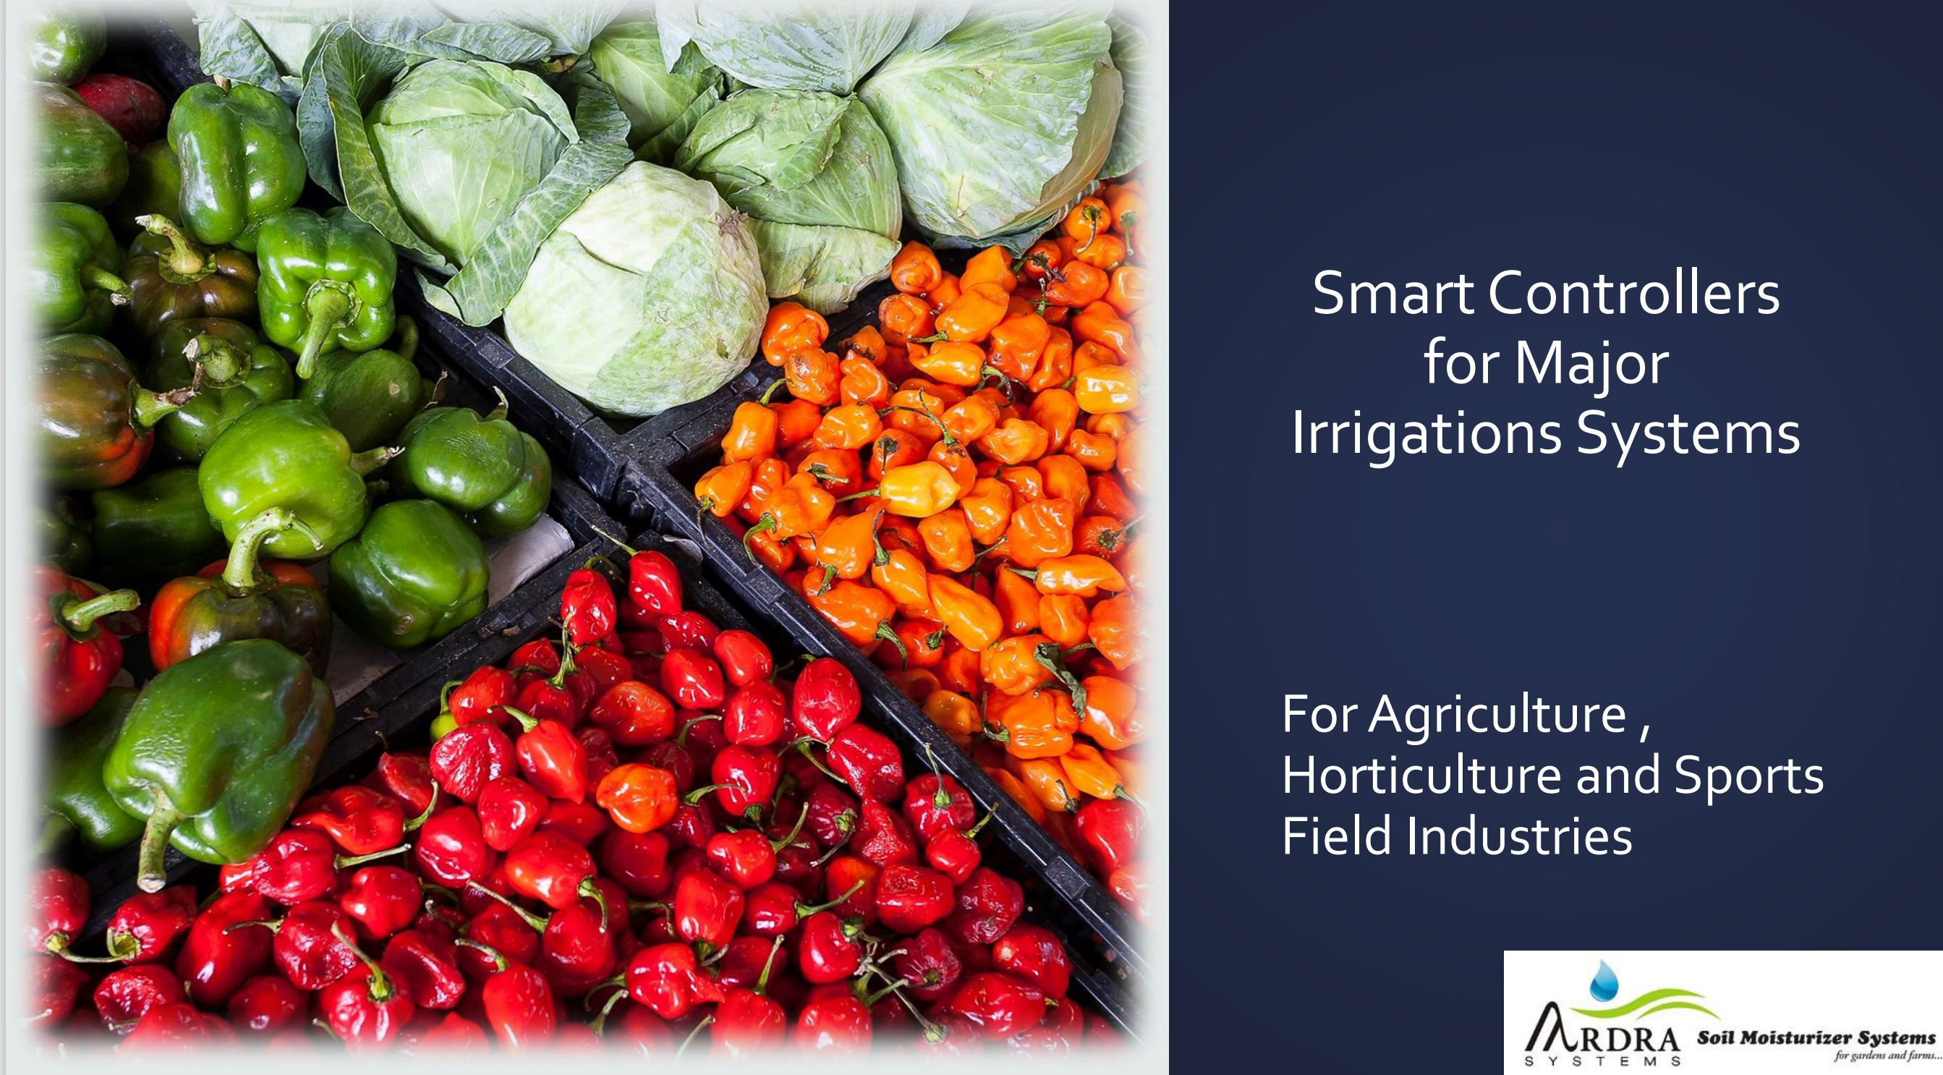

Slide 16
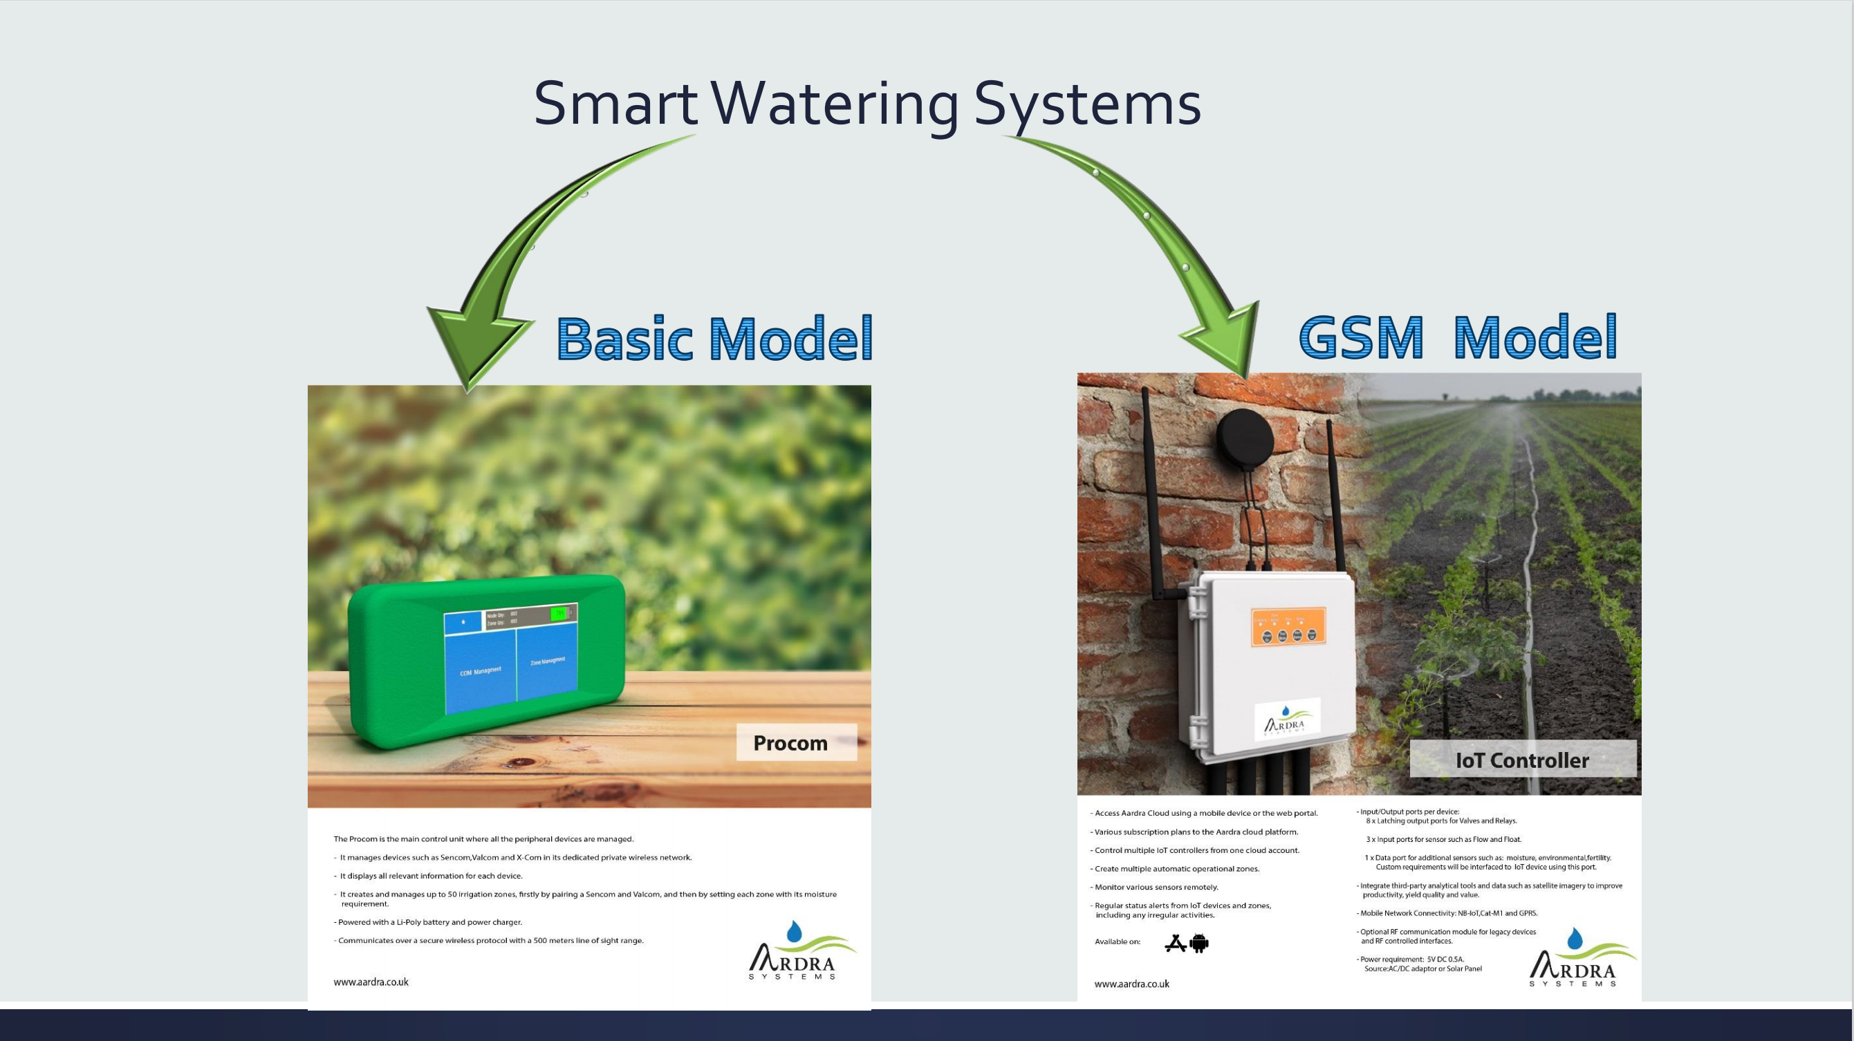

Slide 17
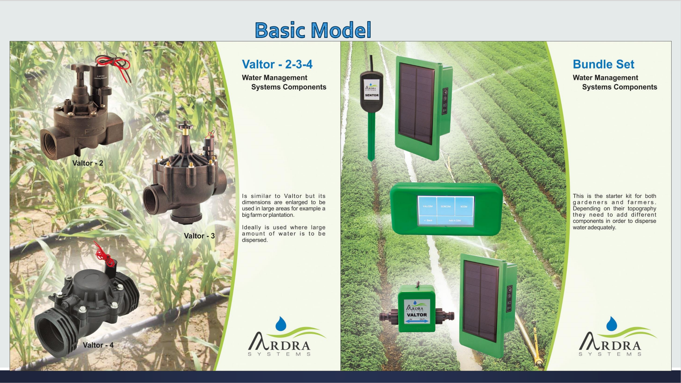

Slide 18
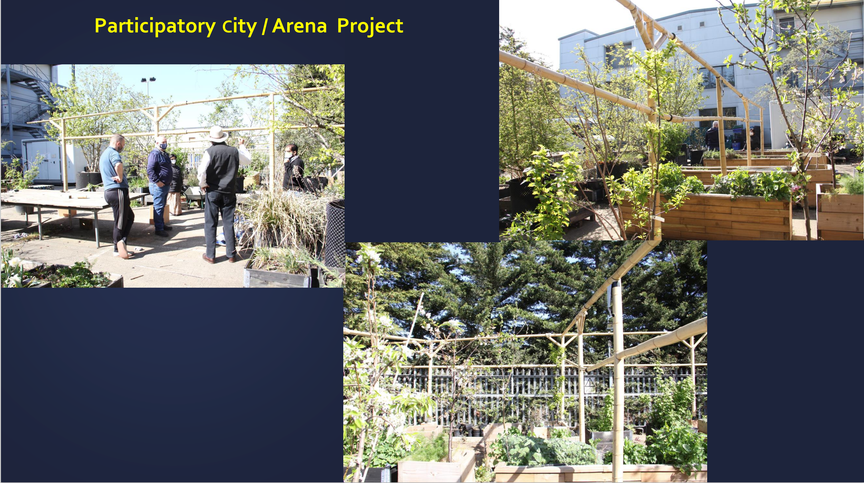

Slide 19
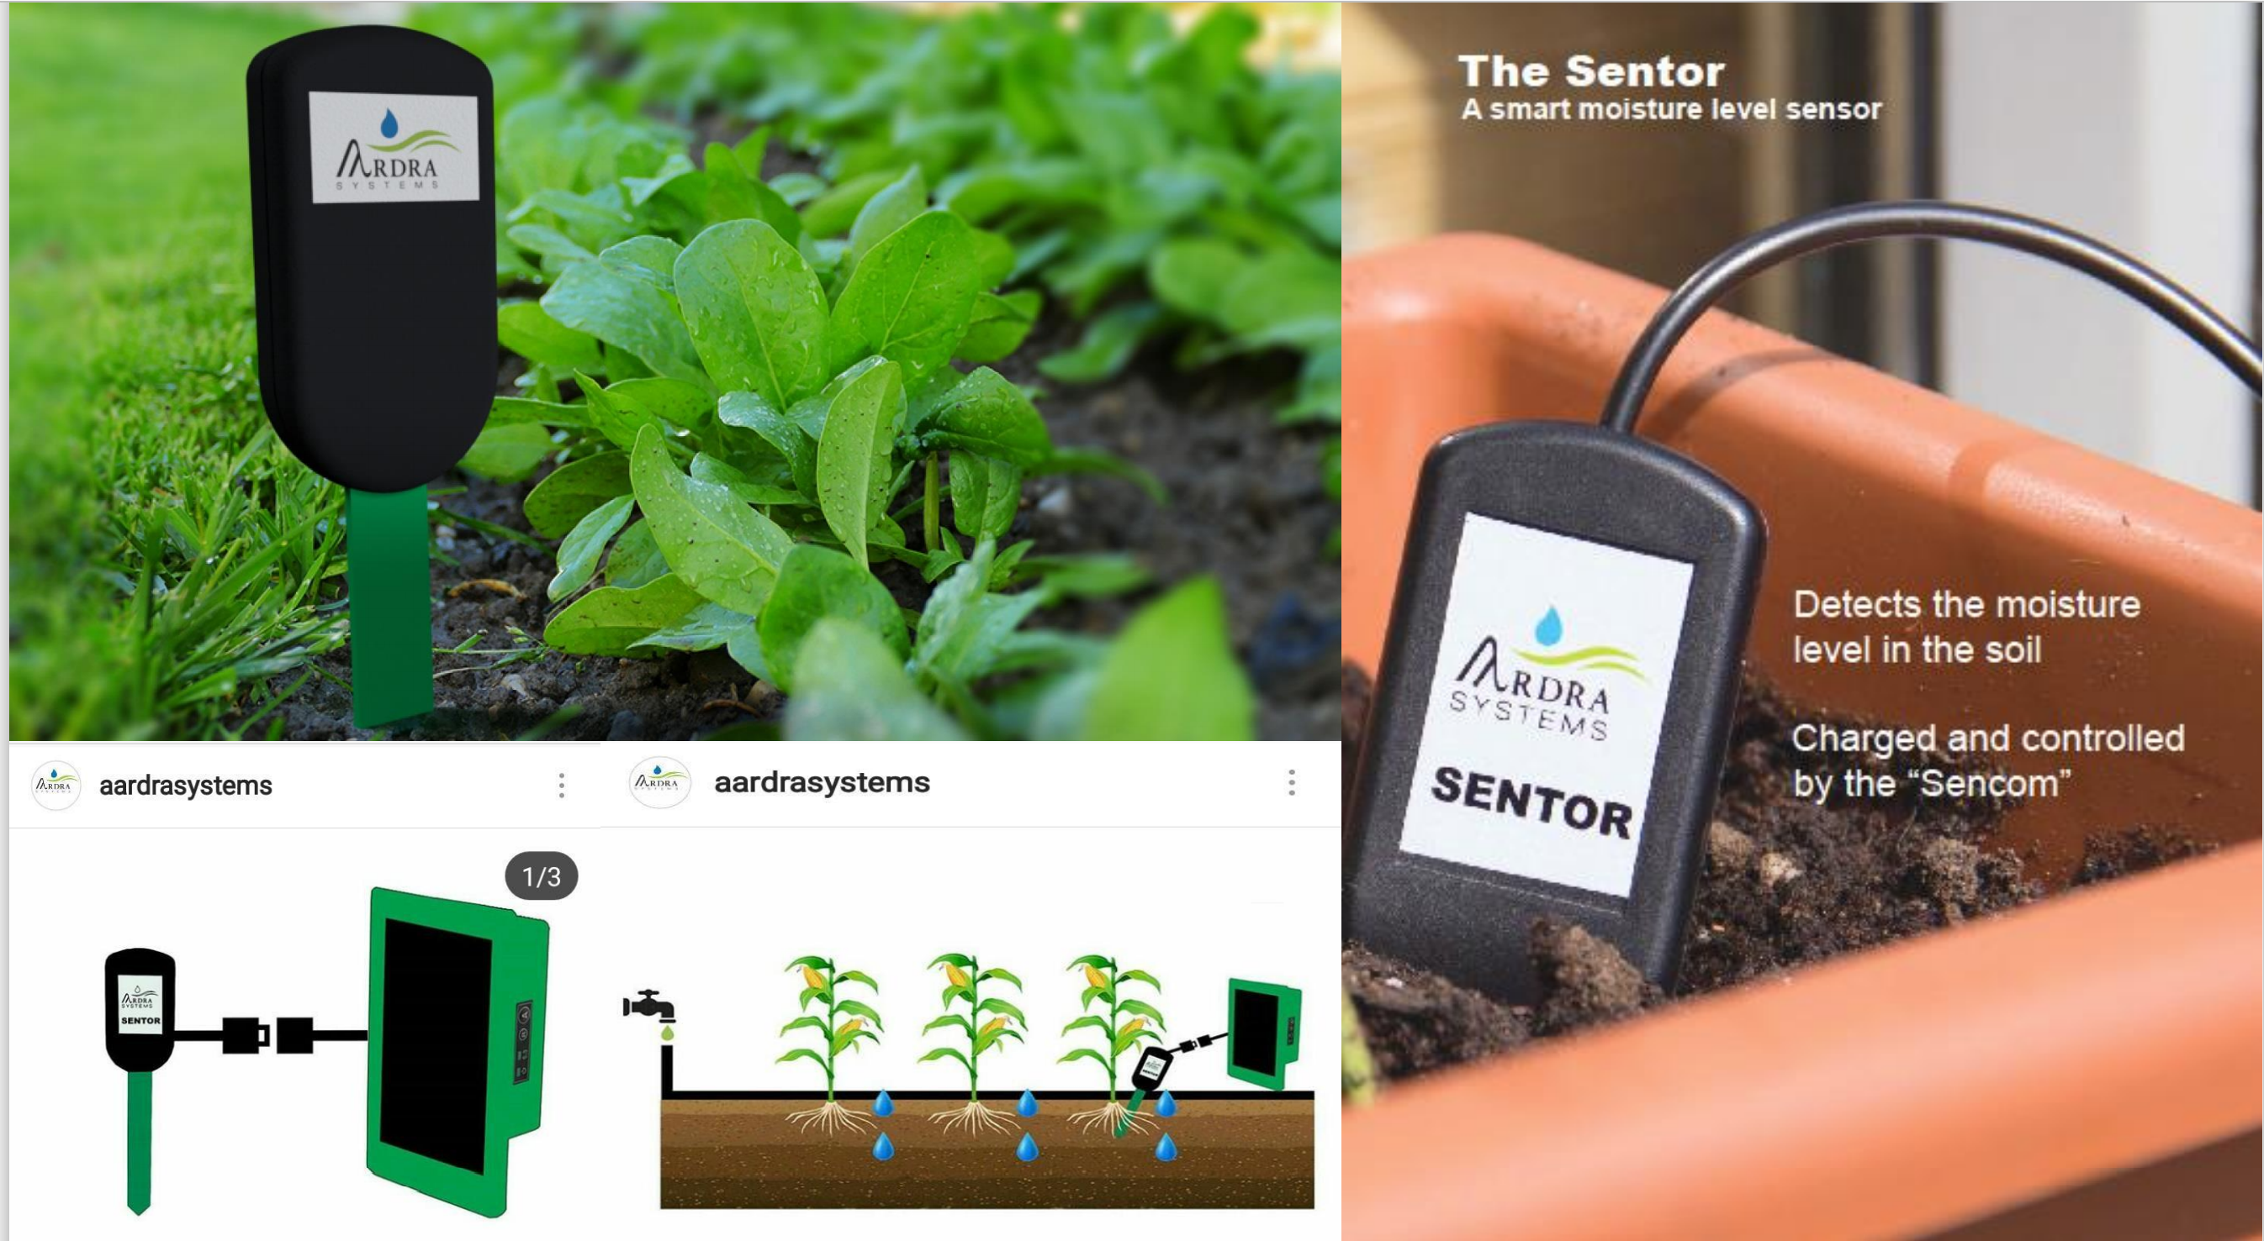

Slide 20
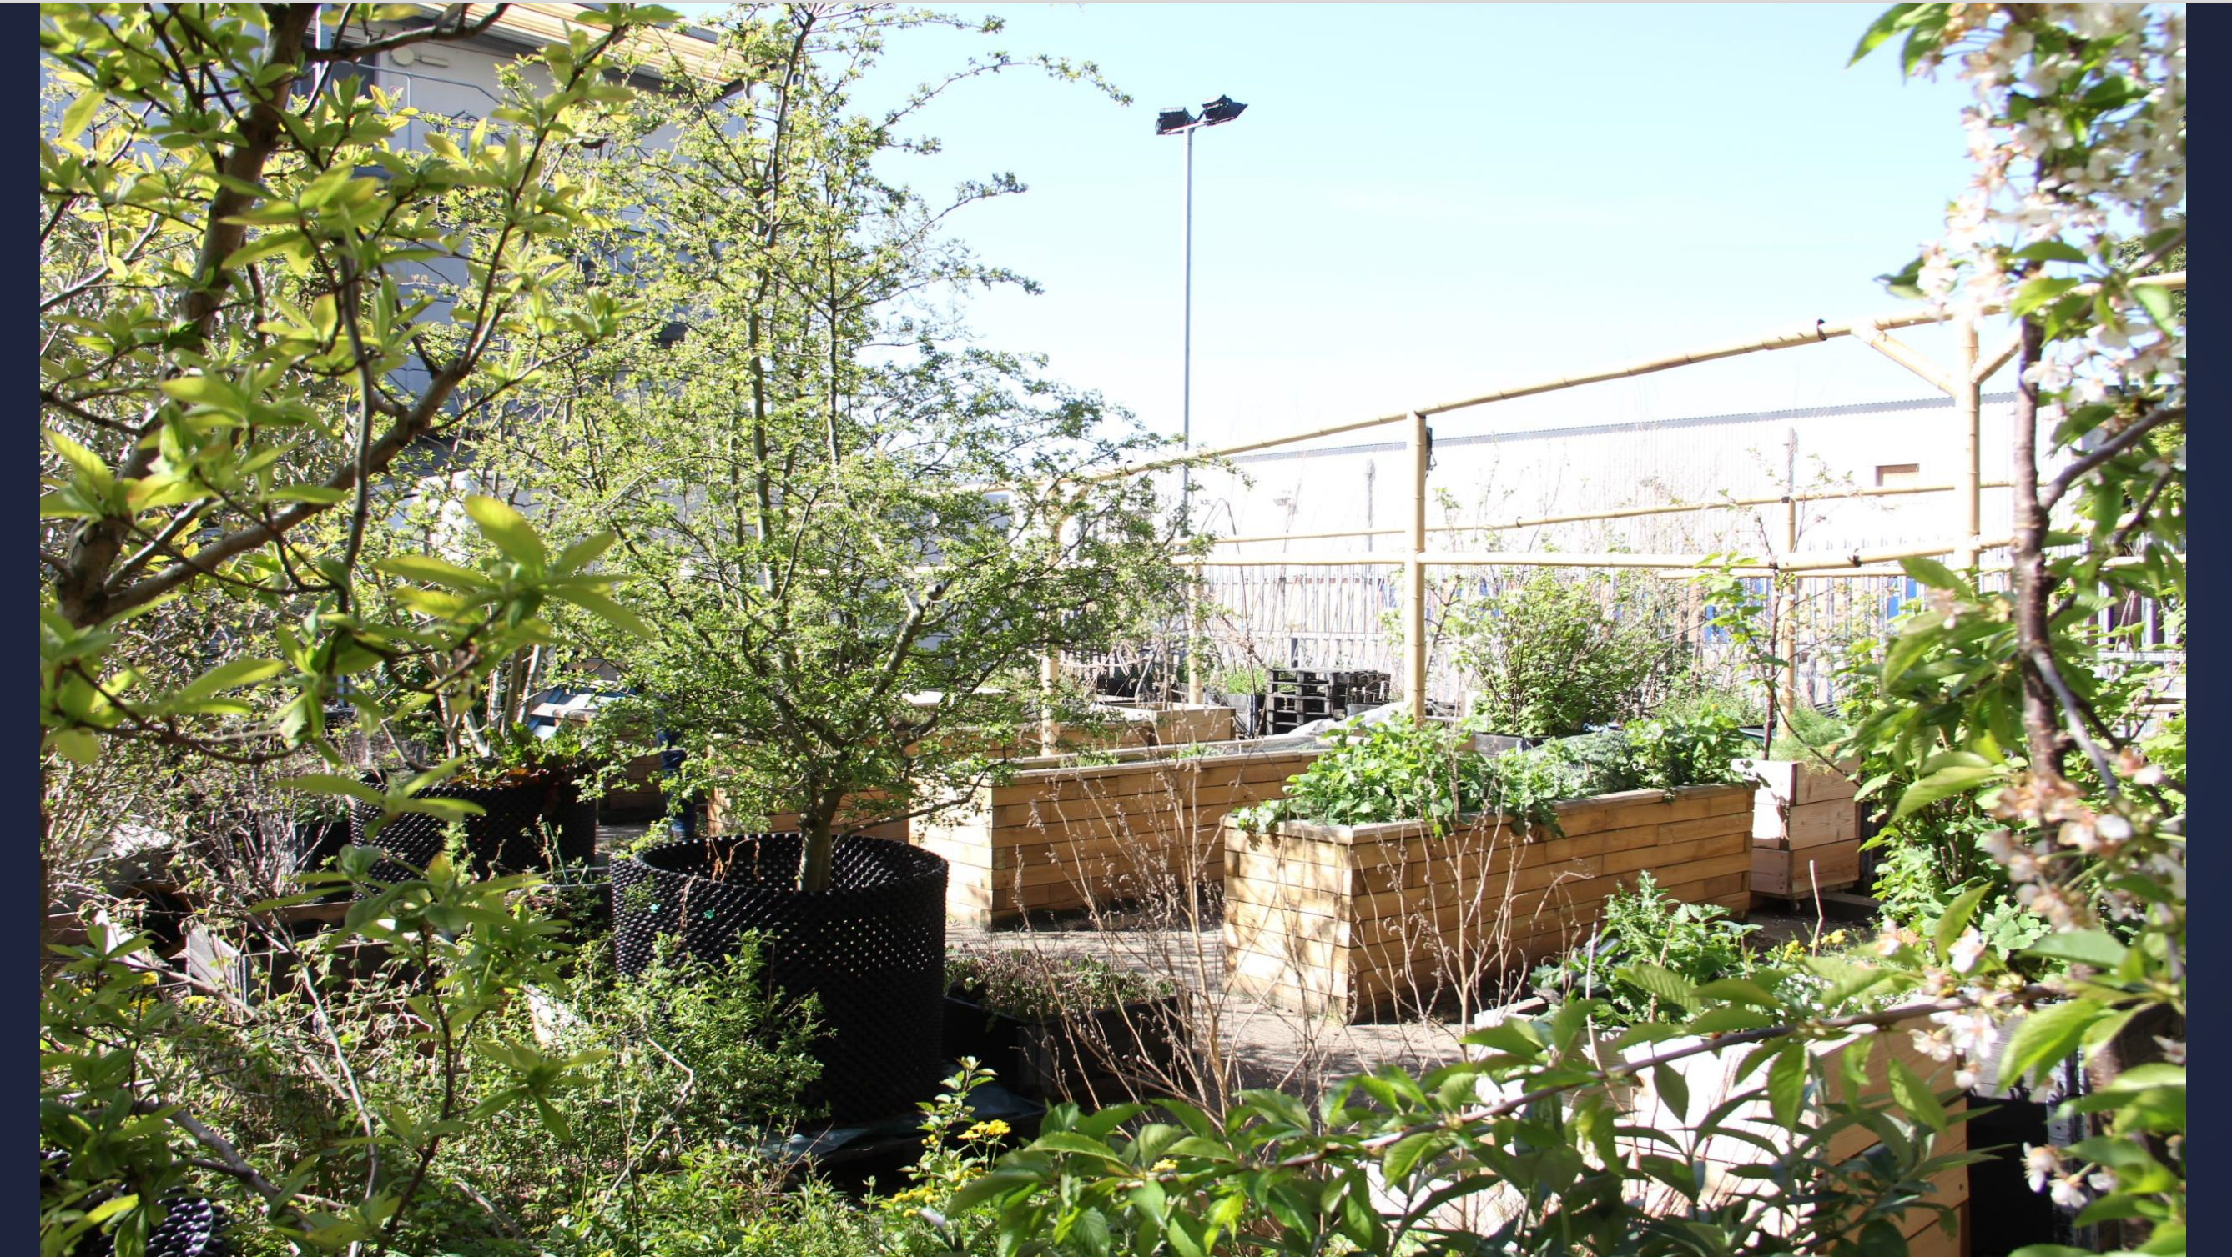

Slide 21
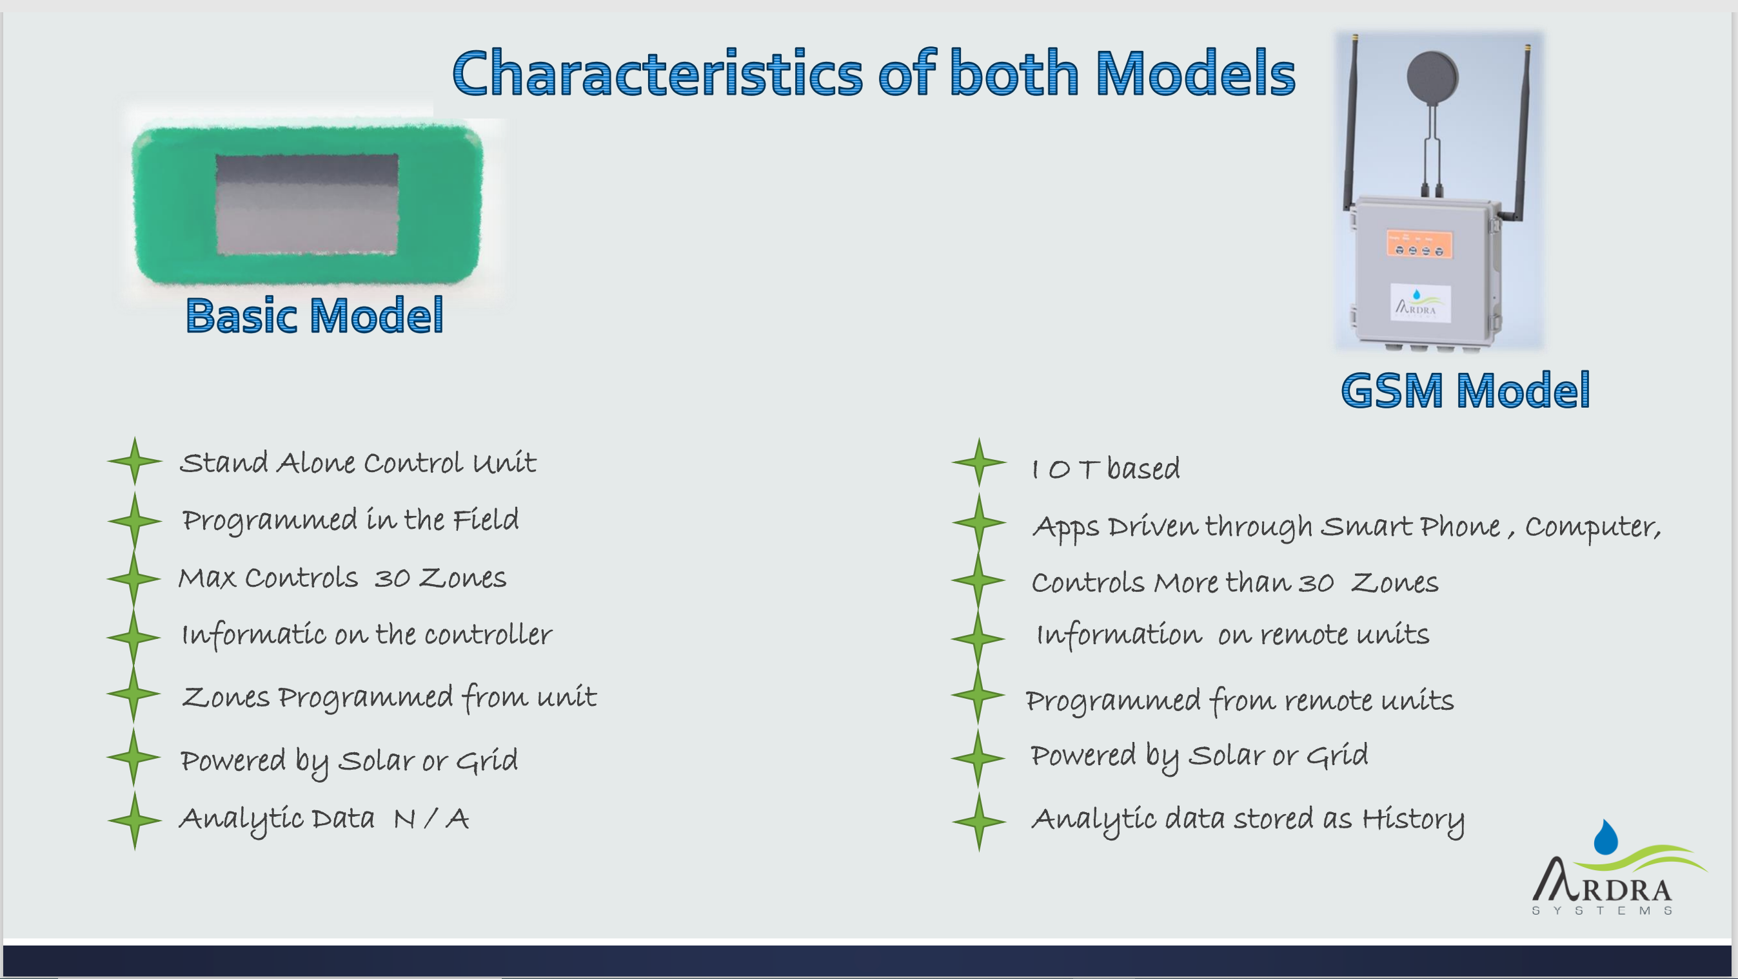

Slide 22
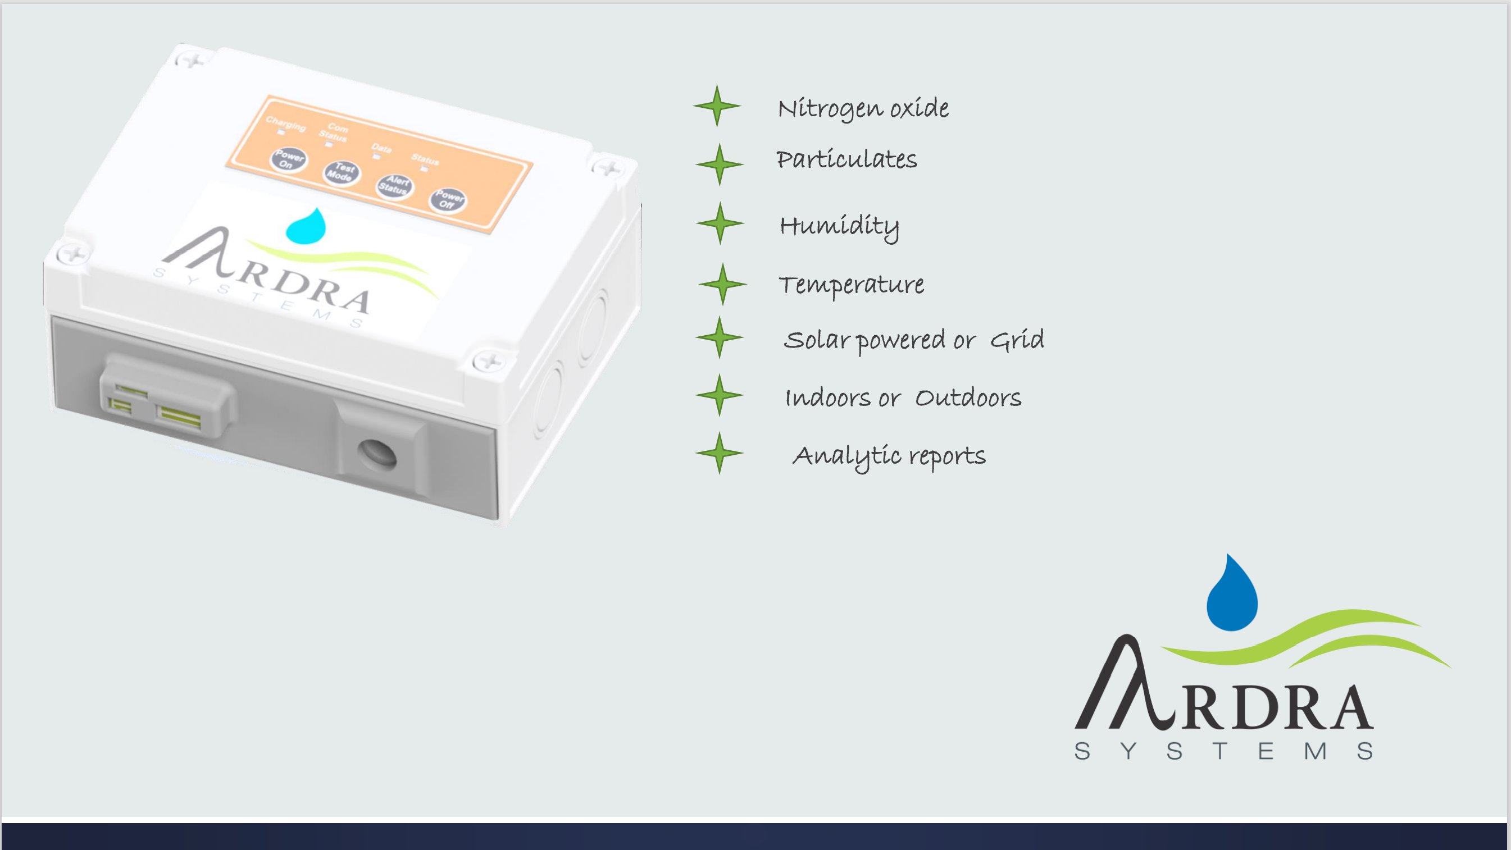

Slide 23
Duncan Boak –
Business Centre Manager, University of East London

Slide 24

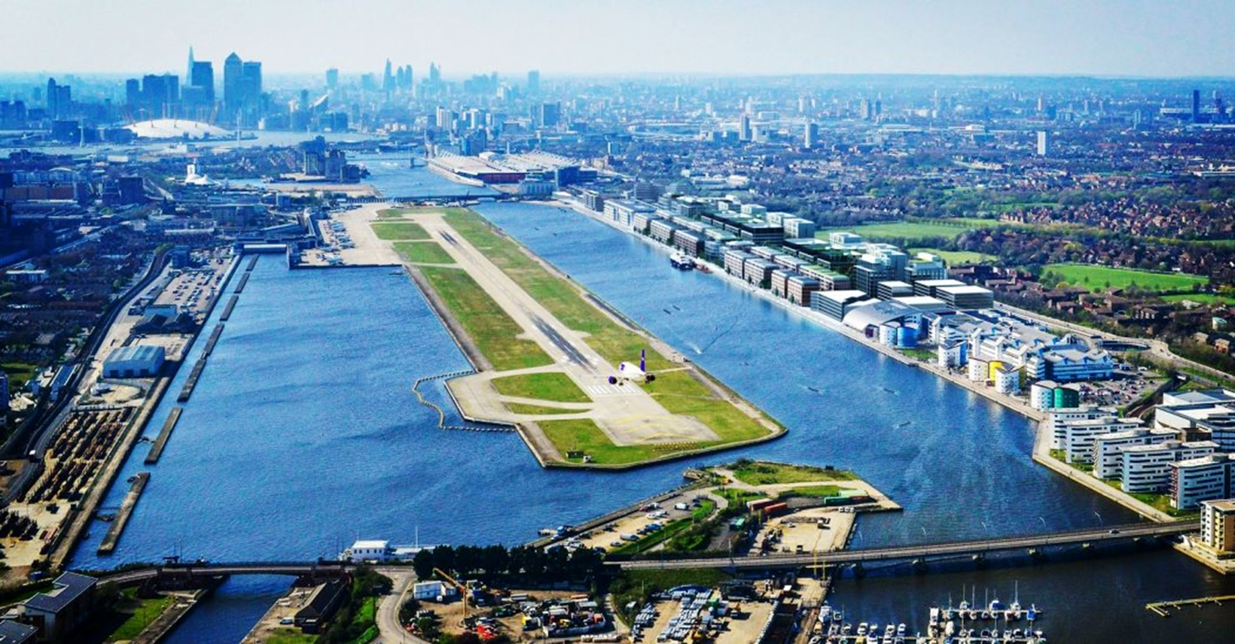
University of East London
Supporting sustainable businesses
in London’s Royal Docks
Duncan Boak
Business Centre Manager
University of East London

Slide 25
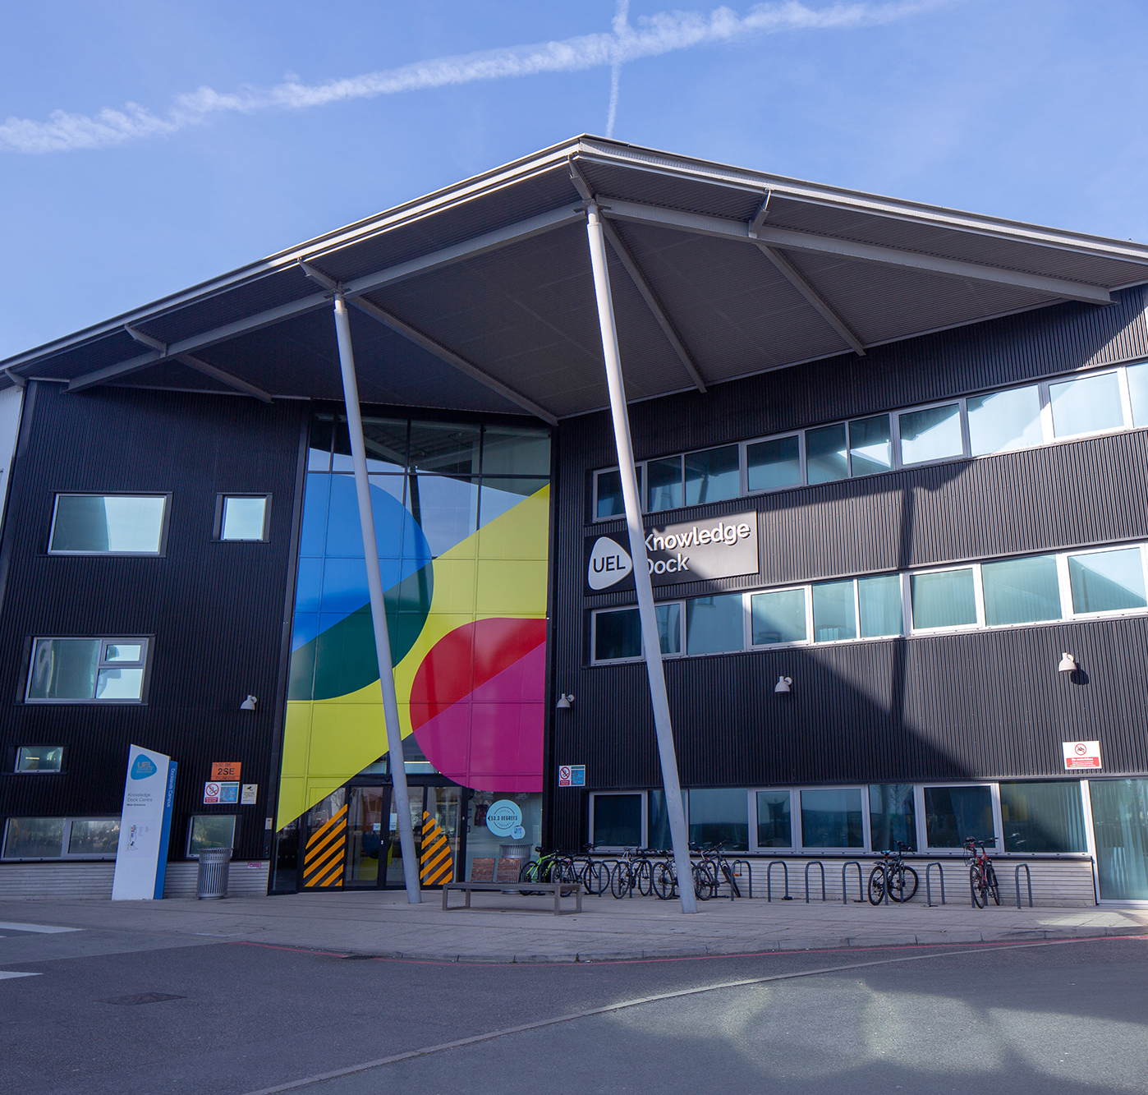
University of East London
Business Centre
  Based in the Knowledge Dock building on UEL’s Docklands campus
  Affordable office and co-working space
  Opportunity for businesses to collaborate with University research expertise and student talent
  Supporting East London businesses and entrepreneurs for over 20 years

Slide 26
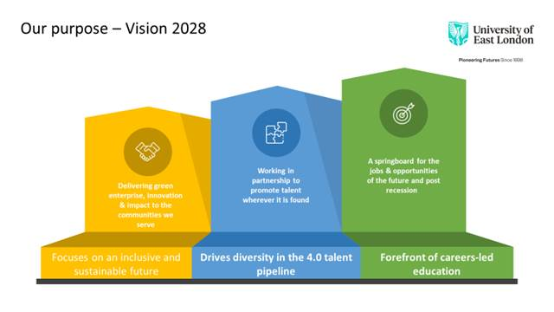
University of East London
Sustainable Enterprise Centre
Supporting the launch, development
and growth of innovative, sustainable
businesses that create good jobs for the
people of Newham
Purpose statement
Focused on an inclusive and sustainable future - delivering green enterprise, innovation and impact to the communities we serve
At the forefront of careers-led education - a springboard for the jobs and opportunities of the future
Driving diversity in the 4.0 talent pipeline - working in partnership to promote talent wherever it is found

Slide 27
Delivering on the strategic objectives of UEL, RD and Newham
Sustainable Enterprise
Centre
Royal Docks Enterprise Zone
University of East London
Borough of Newham
Nationally significant hub of enterprise, employment, culture
Testbed for social, environmental & technological innovation
International focus
Harnessing benefits of Newham’s diverse economy
Deliver green enterprise, innovation, impact
Springboard for jobs and opportunities of the future
Working in partnership to promote talent wherever it is found
Ensure that residents can access good quality jobs in Newham that pay London Living Wage
Support local businesses to become more dynamic and resilient
Promote Royal Docks as incubator for green technology sector

Slide 28
Sustainable Enterprise Centre
Why sustainability?
  Helping businesses to be profitable in the long-term whilst operating with social responsibility and environmental care
  Our vulnerability to global shocks: Covid-19 pandemic, climate change
  Recognition globally, nationally and locally that we need to live and do business in a more sustainable way
  Responding to local needs and motivations: Royal Docks Enterprise Zone and Newham’s strategic objectives

Slide 29
Sustainable Enterprise Centre
Goals
Job creation: good jobs for local people and UEL graduates
Business support and development: Launch, grow and attract businesses to the Royal Docks
Innovation: Support businesses that are focused on finding solutions to glocal challenges
Community wealth building: Connecting businesses, local communities, investors, students, researchers

Slide 30
Sustainable Enterprise Centre
Services and support
Business start-up: Support local people, UEL students & graduates in starting their own sustainable enterprise
Acceleration programme: Scale-up of green, tech, socially impactful organisations
Membership: Affordable workspace, access to University expertise and facilities for established businesses
Inclusivity: Support for underrepresented entrepreneurs
Community organisations: Support and peer networks
International connections: Soft landing, joint programmes with international partners
Networks: Local experts and investors

Slide 31
Sustainable Enterprise Centre
Working with the Royal Docks Enterprise Zone and LB Newham
A glocal eco-system
Working with pan-London organisations such as the GLA, London CleanTech network, Growth Hub and others as part of a unified approach to innovation and sustainability
Local
Partnerships with the Launchpad at Western Sydney University, iAccelerate at Wollongong University, Tongji University provide sharing of best practice, joint programmes, exchange and soft landing
London-wide
International

Slide 32

Sustainable Enterprise Centre
Measuring Impact – the UN Sustainable Development Goals
  The SEC will support businesses to monitor and measure their impact against the SDGs

Slide 33
Sustainable Enterprise Centre
Understanding East London’s needs
What support does your organisation need now, and what do you think you’ll need support with in future?
How could the Sustainable Enterprise Centre benefit your business?
Email: dboak@uel.ac.uk

Slide 34
Tom Brennan –
Business and Marketing Director, St Johns Laboratory

Slide 35
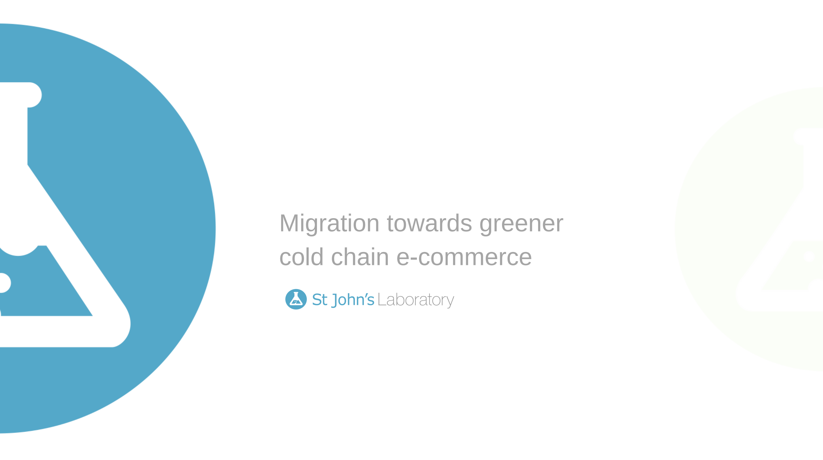

Slide 36
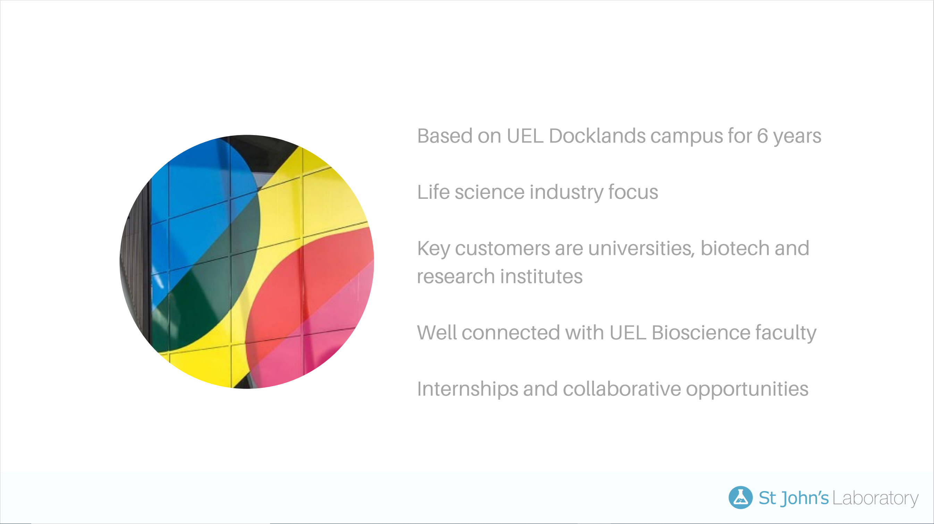

Slide 37
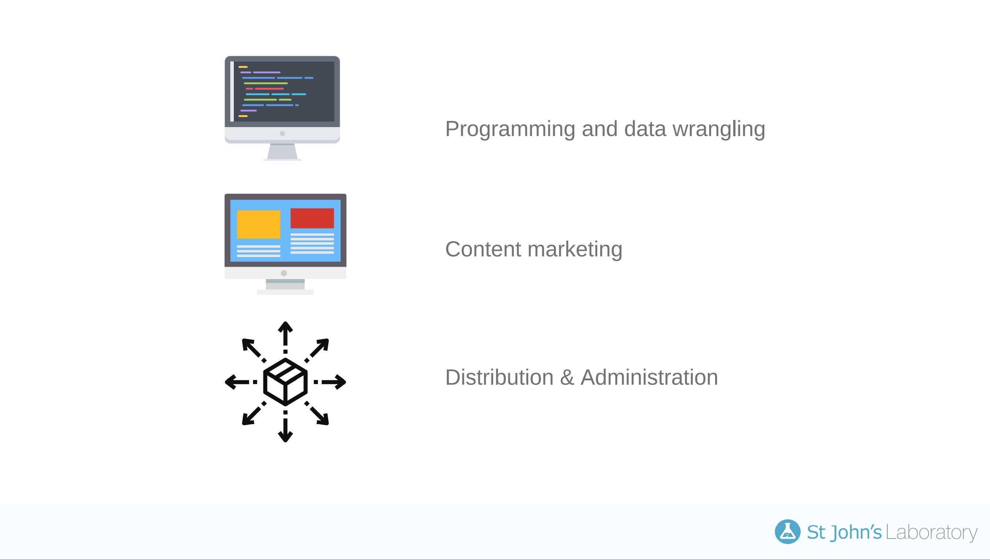

Slide 38
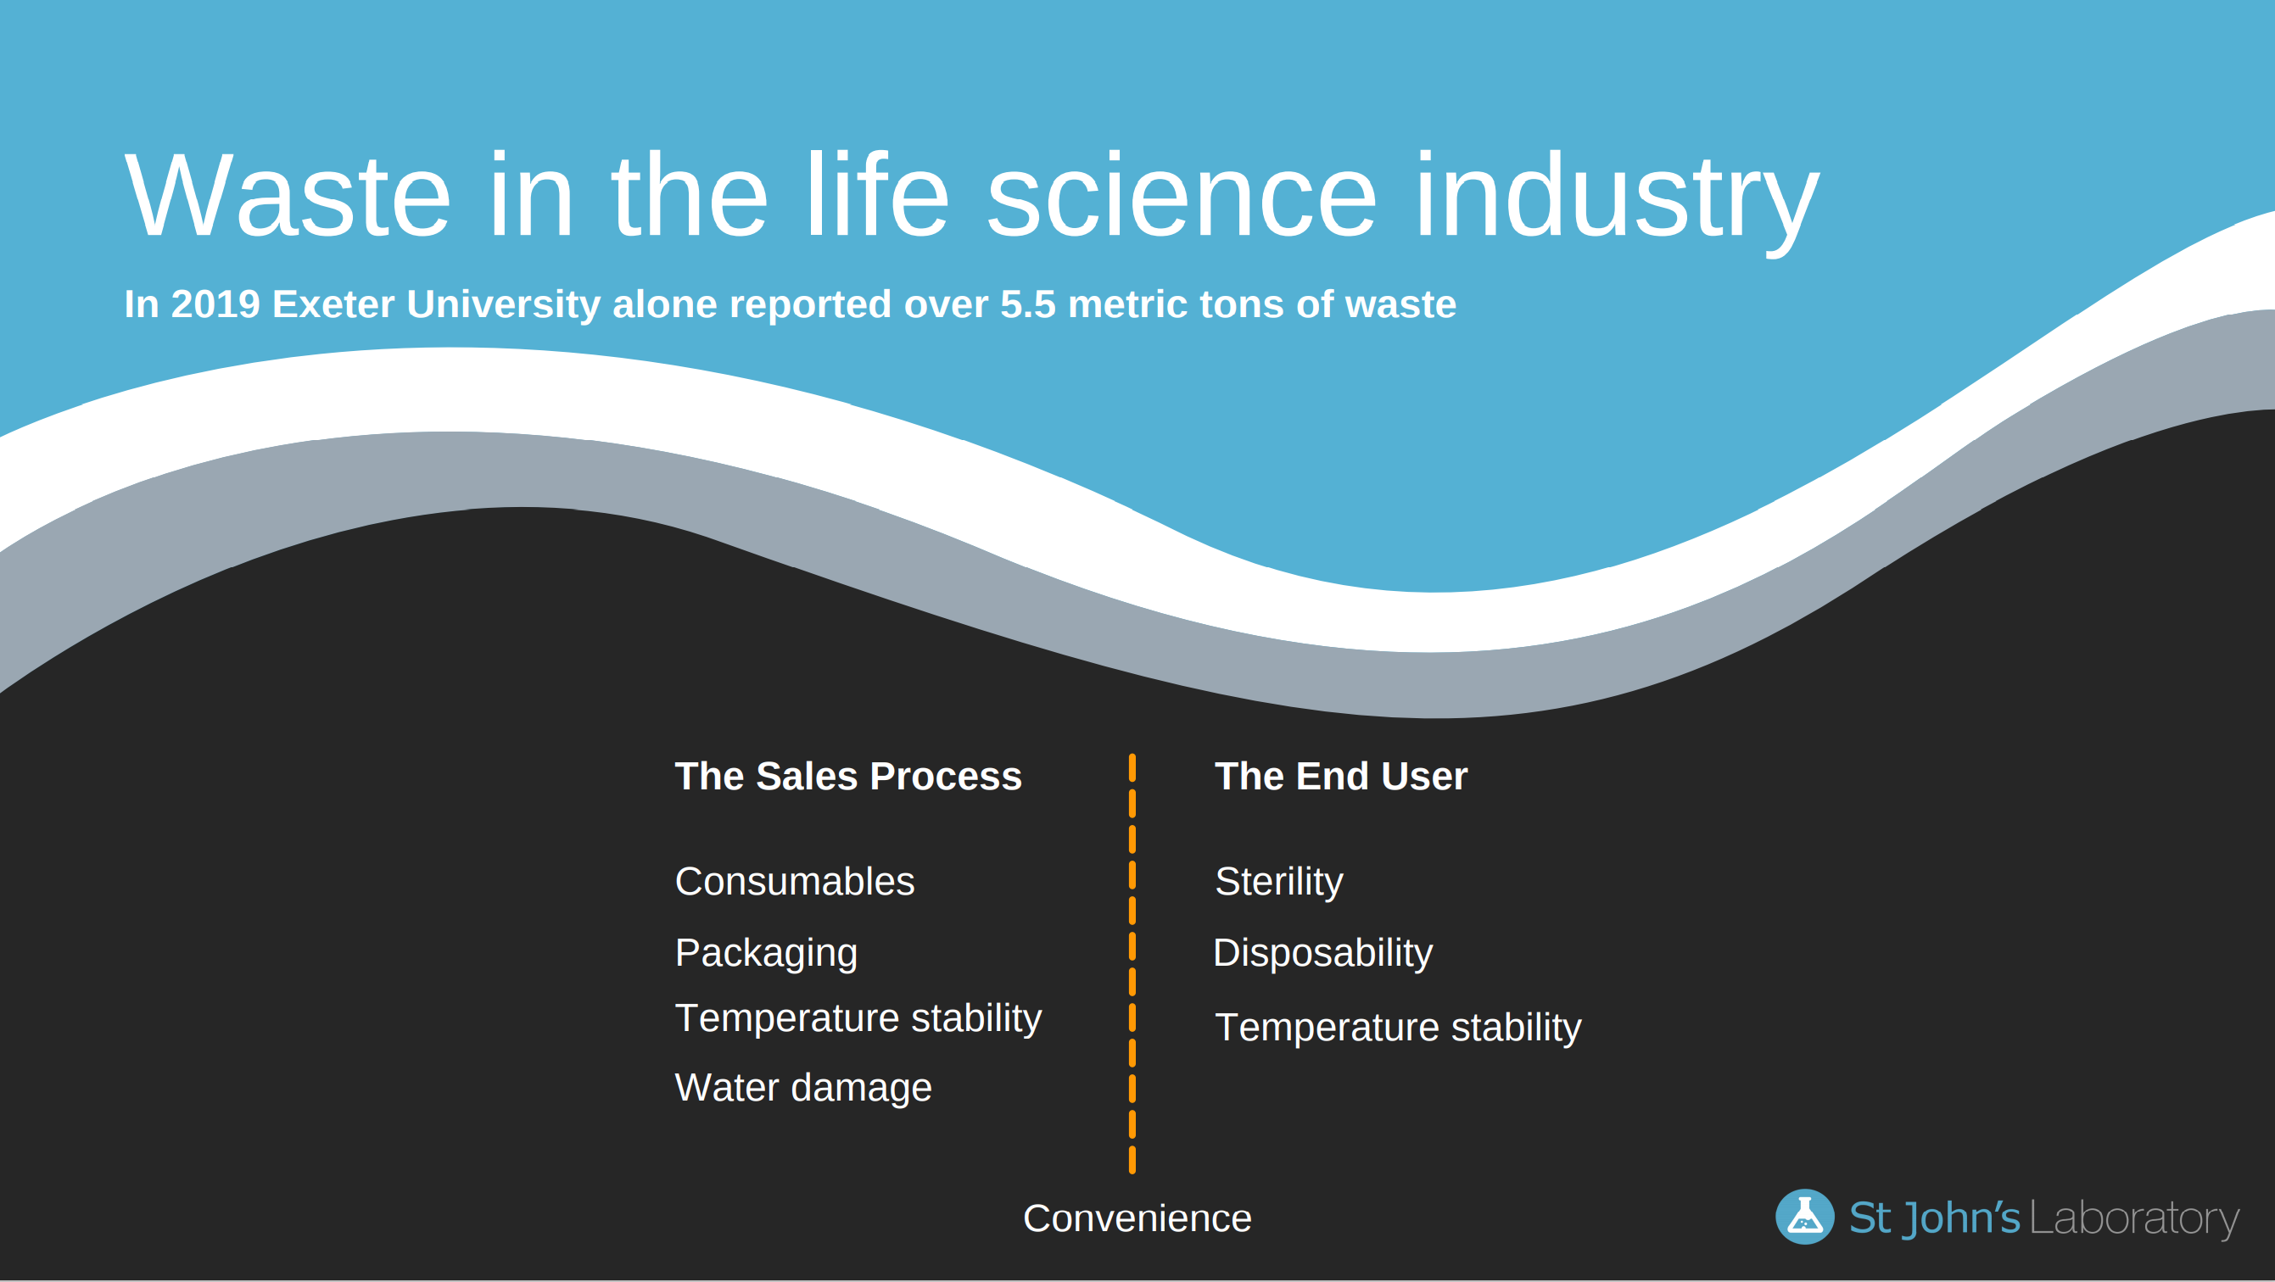

Slide 39
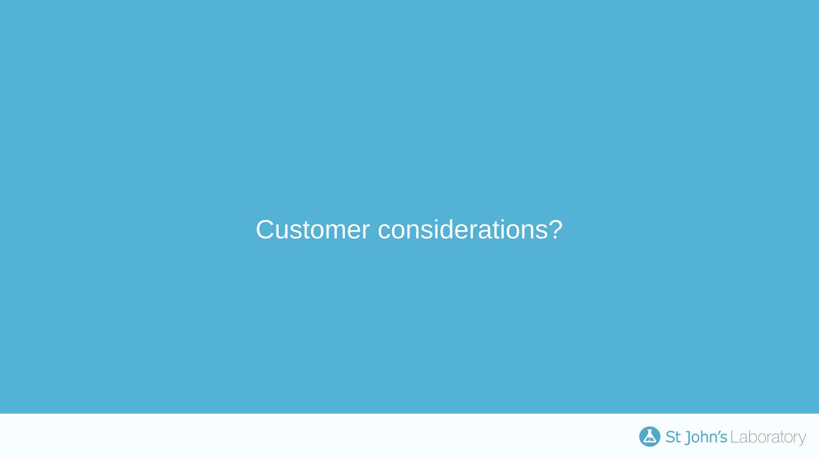

Slide 40
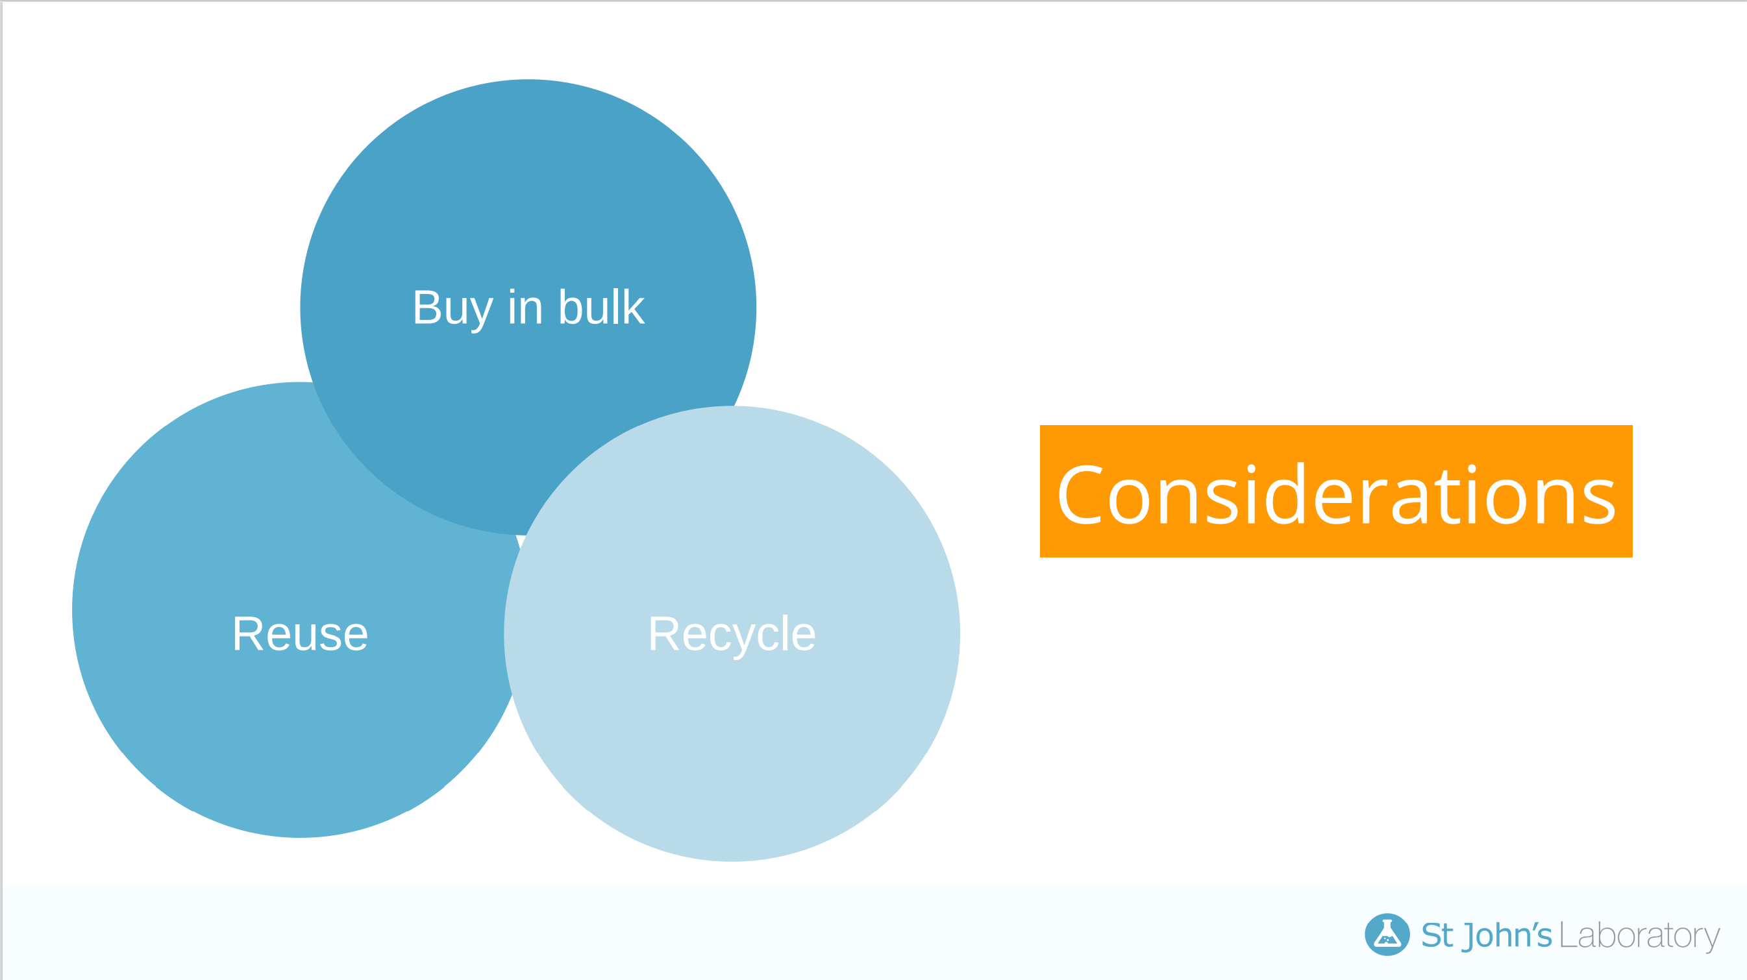

Slide 41
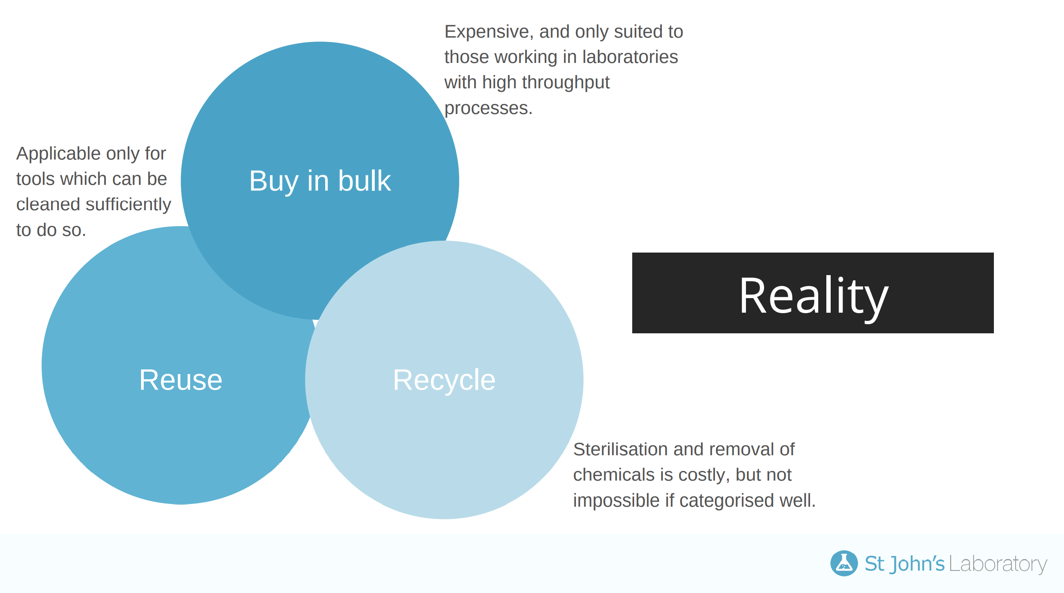

Slide 42
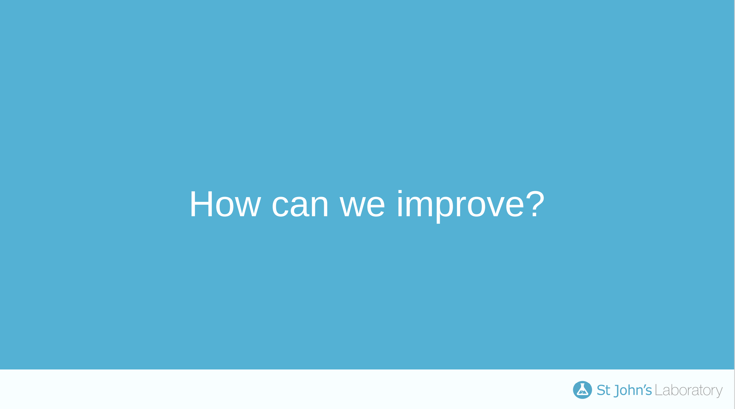

Slide 43
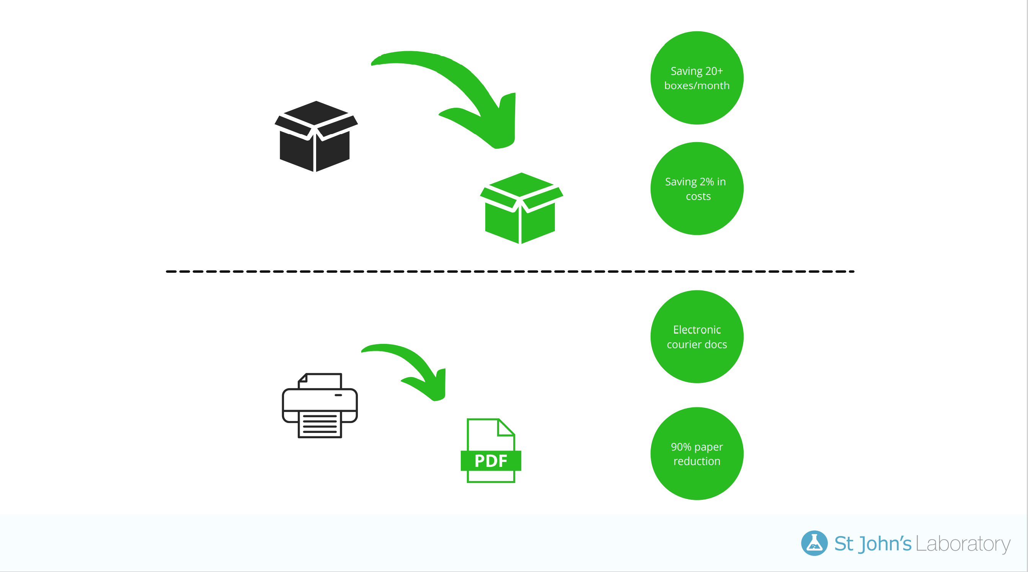

Slide 44
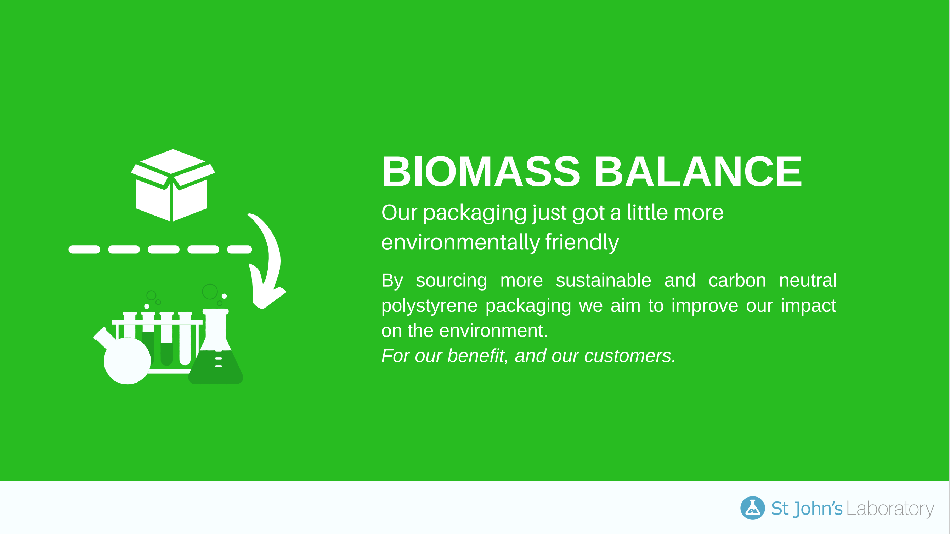

Slide 45
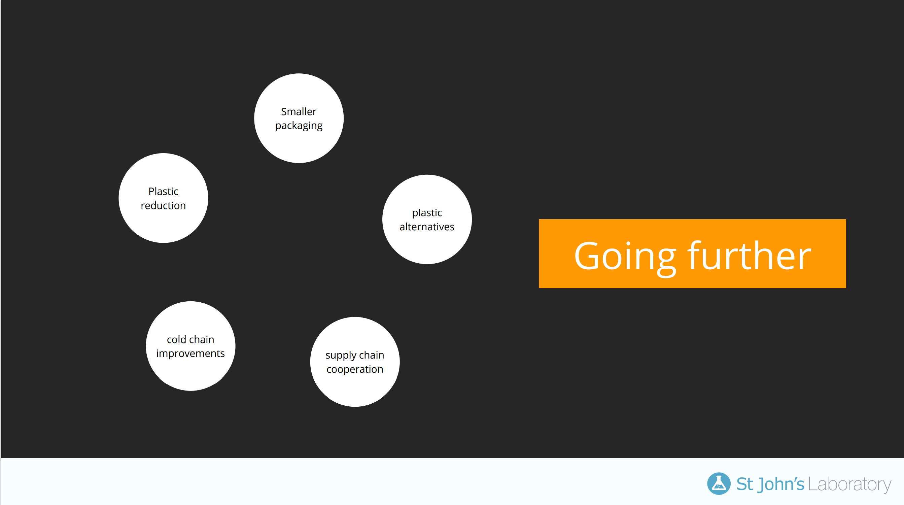

Slide 46
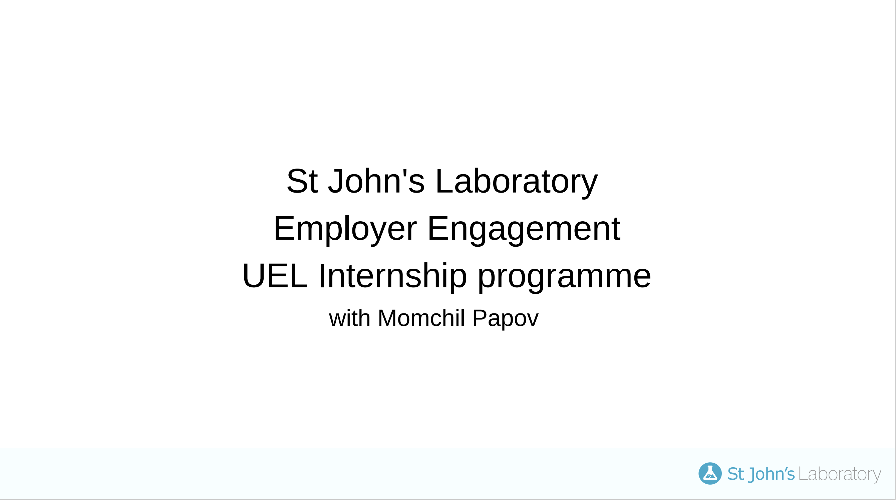

Slide 47
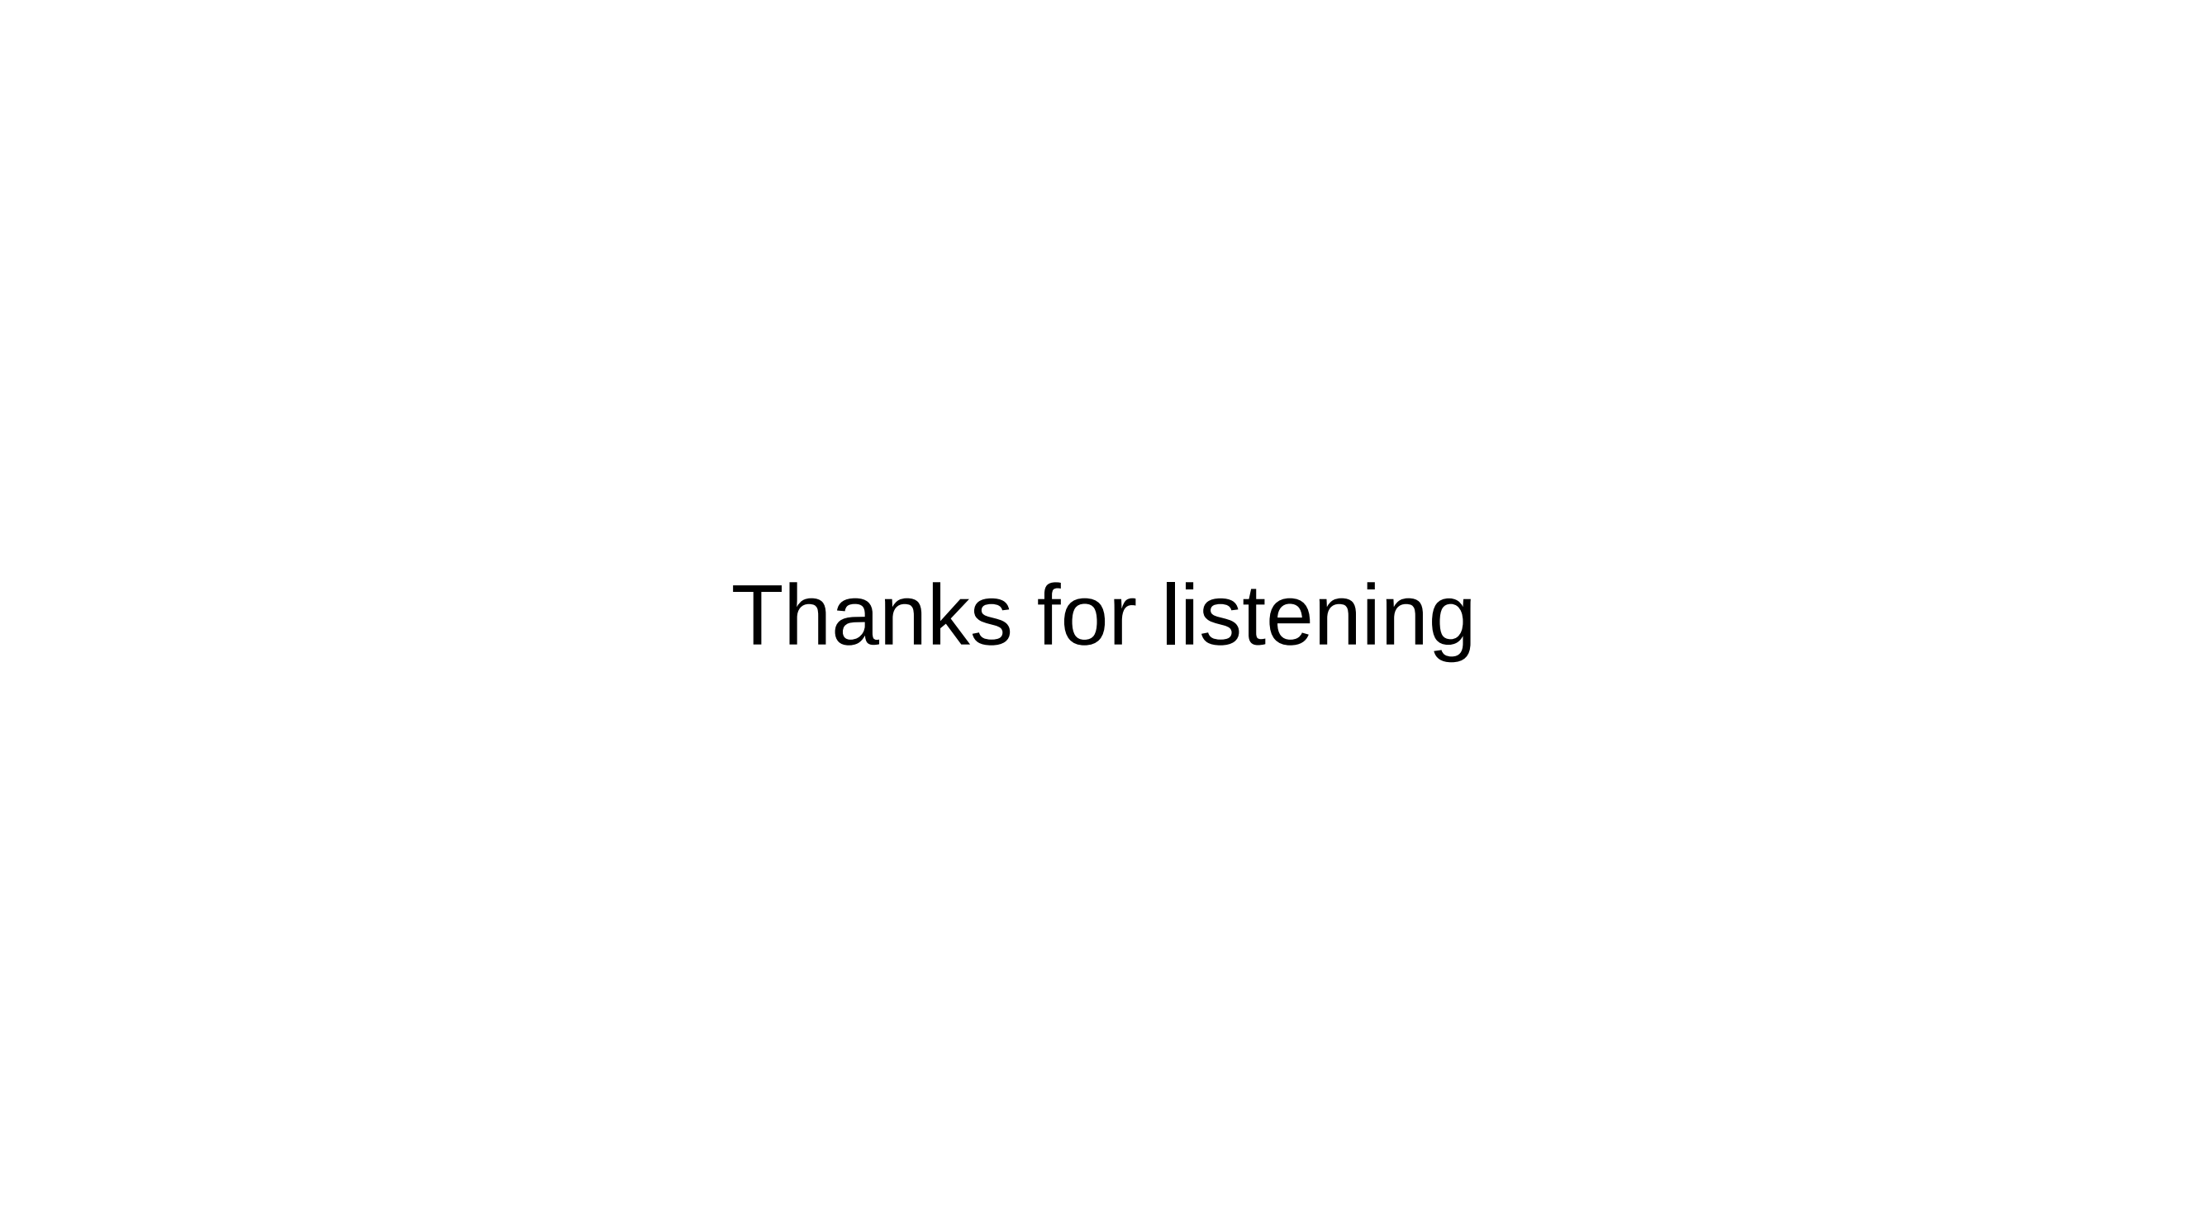

Slide 48
Matt Davies –
Head of Economic Development, Royal Docks Enterprise Zone

Slide 50
Developing a Green Tech Quarter in London’s Royal Docks
Matt Davies
Head of Economic Development, Royal Docks Enterprise Zone
matt.davies@London.gov.uk
07971 131 373

Slide 51
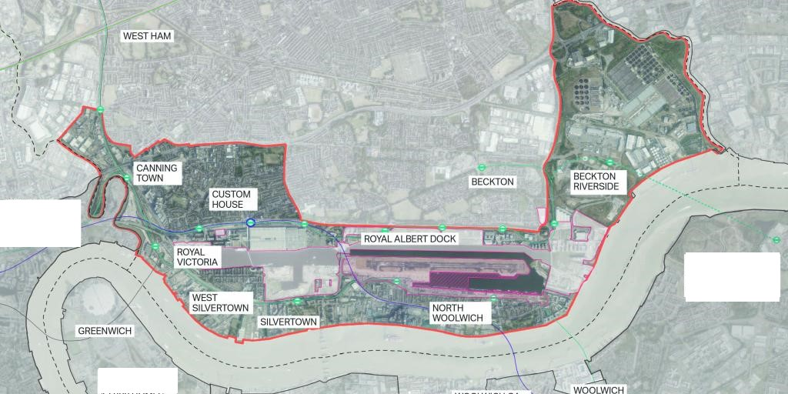
Royal Docks Enterprise Zone

Slide 52
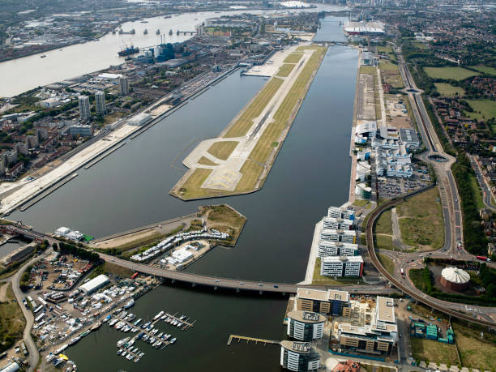
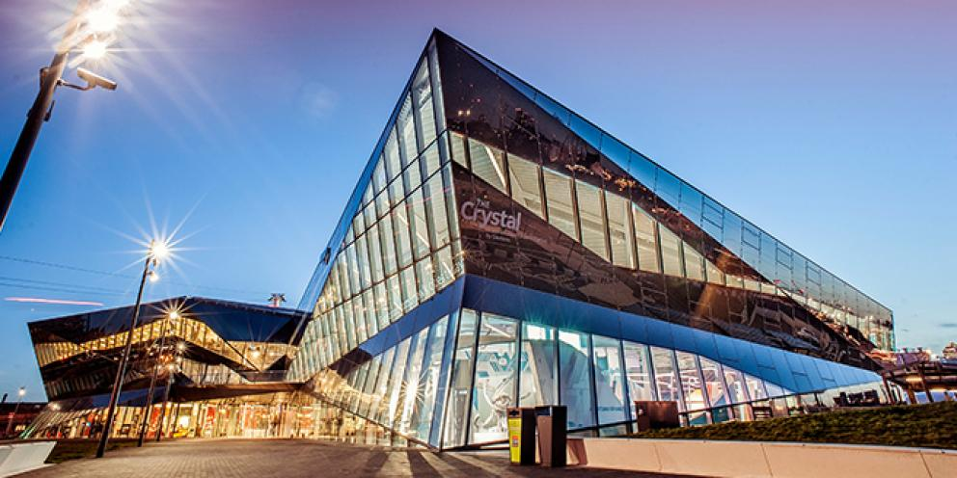
Economic purpose
“A nationally significant hub of enterprise, employment and culture; recognized as a testbed for social, environmental and technological innovation. Globally fluent and internationally focused, harnessing the benefits of Newham’s diverse community.”

Slide 53
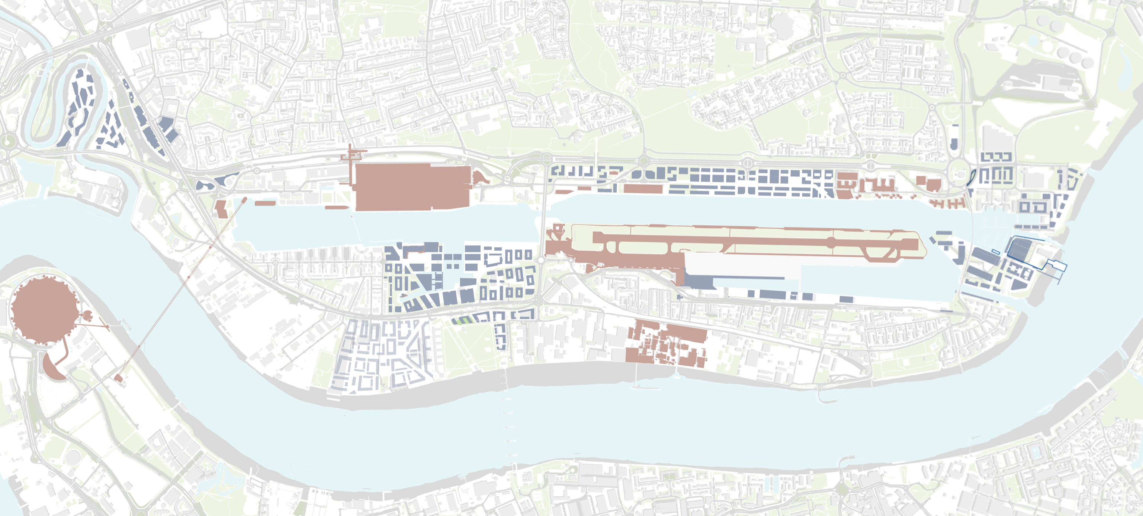


























































Social Innovation
FBST
Business Tourism
Other
Green Tech
Creative & Urban
Sector-spatial economic vision
Notes:
xxxx

Slide 54
Green Tech
Green Tech focus
Notes:
xxxx

Slide 55








Royal Docks Green Tech Quarter – Core
Royal Docks Sustainable Innovation, Enterprise and Communities (SIEC) Centre
71,000sqft of flexible work, learning and innovation space
Sustainability Research Institute
Academic centre of excellence for environmental research and development
RAD office quarter
450,000sqft (Phase One) of high quality move-on space for growing green enterprises
London’s Enterprise Zone
Co-ordination and funding support to help choreograph the future development of the Royal Docks
Manufacturing and Prototyping Hub
Dedicated centre for prototyping and light-manufacture of emerging green technologies
The Ideas Factory
215,000sqft flexible ‘flatted factory’ for industrial, warehouse, manufacture and educational use
Digital District
An active testbed for pioneering green infrastructure technologies
Future Neighbourhoods – North Woolwich and Beckton
Mayor of London investment in supporting the Royal Docks to realise its vision of the future and design a green recovery
Notes:
xxxx

Slide 56











Royal Docks Green Tech Quarter – Supporting
Local communities
London’s youngest and most diverse borough
London Borough of Newham
Committed to becoming London’s greenest economy
Crossrail
Opening 2022 with fast direct links to central and west London
ExCel Centre
London’s premier international conference facility
Soldier of Orange
Iconic and unique theatre production
Commercial boatyard
London’s newest commercial boatyard
City Hall
Home of London Government – Green New Deal
Silvertown Tunnel
Road tunnel linking North Greenwich with Royal Docks – open 2025
Silvertown Quays
New commercial heart includes new town centre and redevelopment of iconic Millennium Mills
Dock water
Europe’s largest man-made enclosed water space – 100 year old home of London’s global identity
London City Airport
Sustainability Strategy due summer 2021
Tate & Lyle research centre
Pioneering research and investment facility
Notes:
xxxx

Slide 57
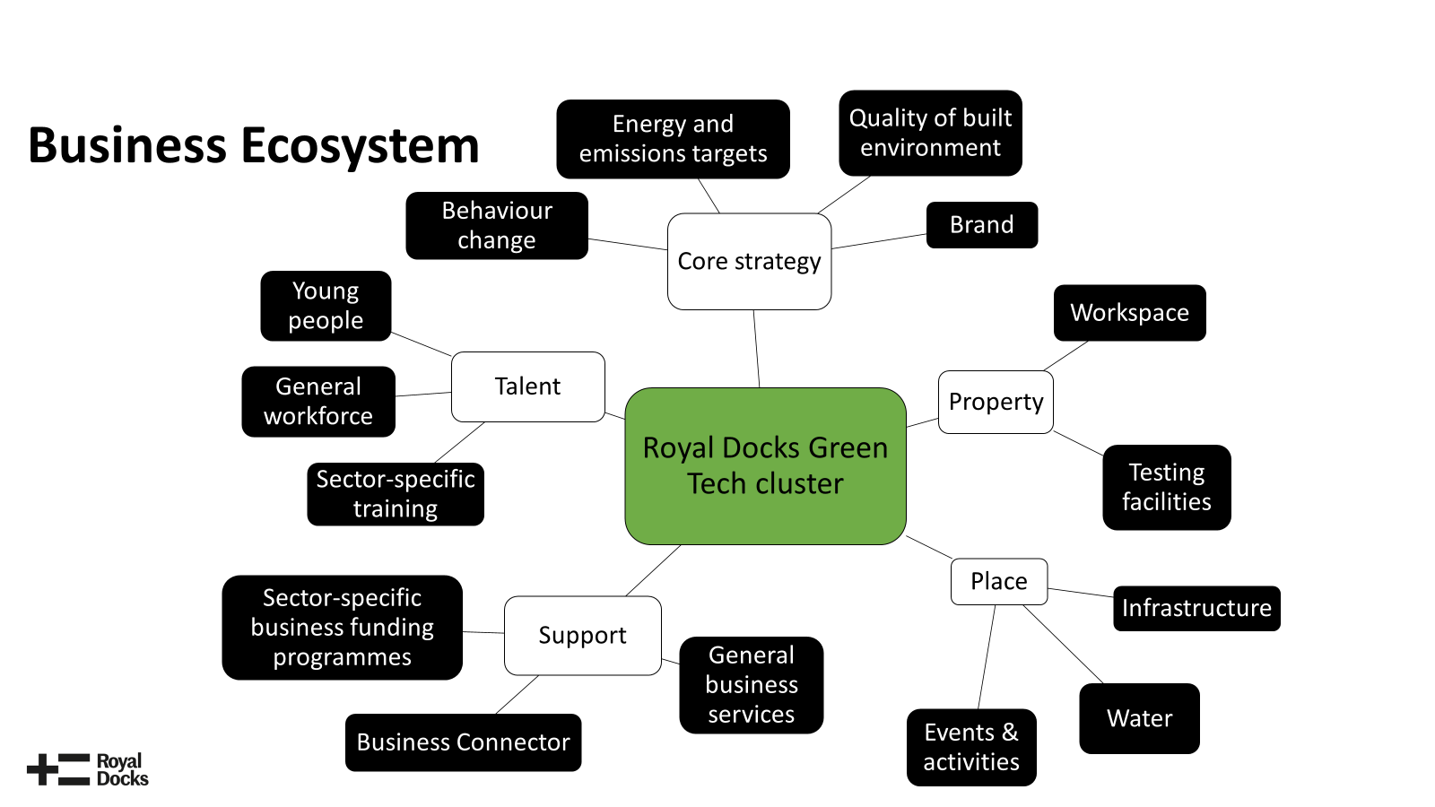

Slide 58
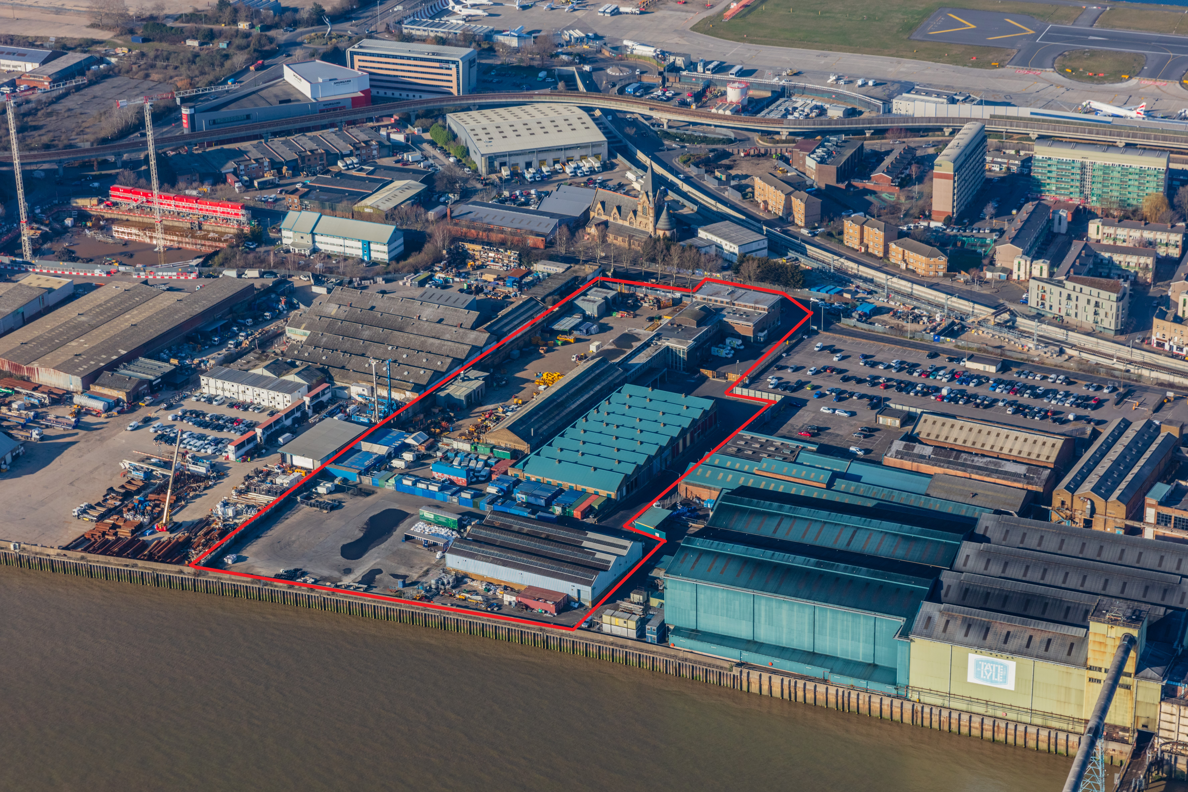
The Factory project
Partnership between Projekt and T&L
C.£2.8m grant from Royal Docks GGF
100,000 sqft of affordable workspace being created or improved
Two local charities safeguarded on a rent free basis with improved facilities
195 jobs associated with the operation
30 Cultural Events a year
20 Community Events a year
Free spaces offered to local community groups and organisations
Scheduled for completion December 2021

Slide 59
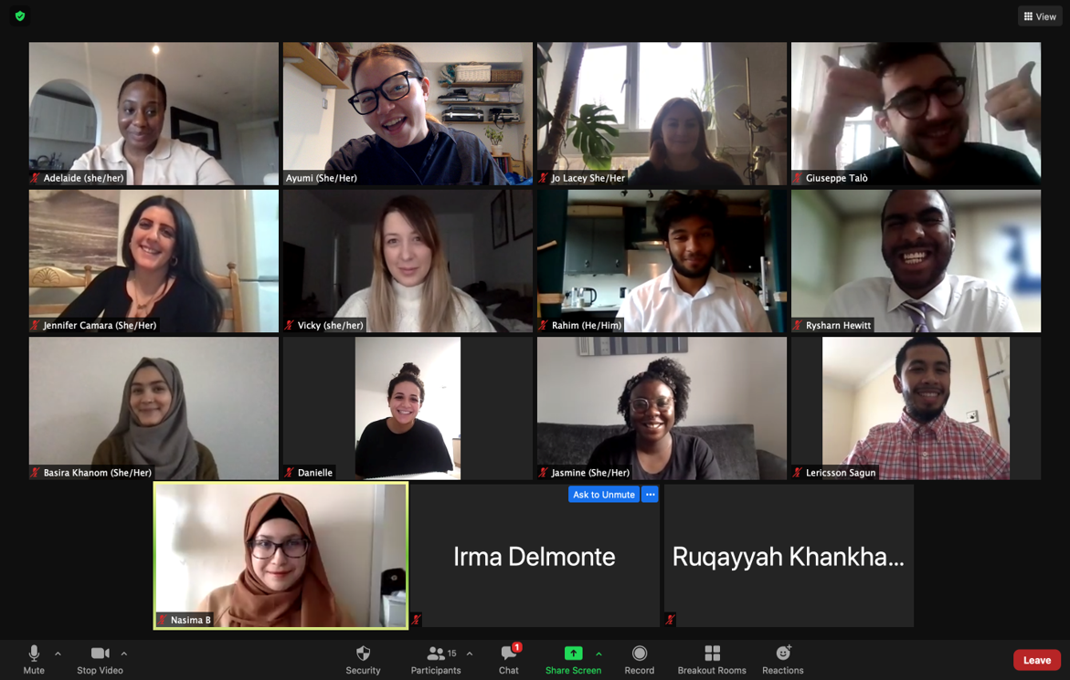
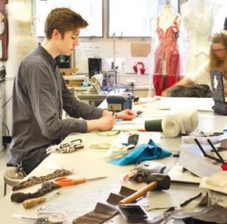
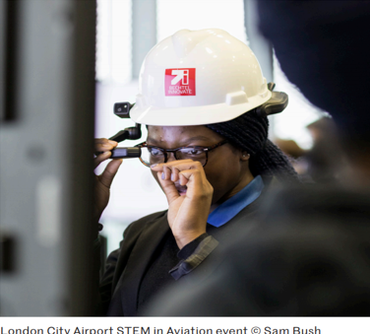
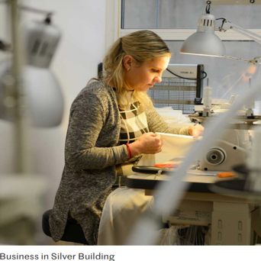

Notes:
Economy
The Internship Programme:
In October 2020, we launched our ‘Royal Docks Internship Programme’. Focussing on the 18 – 30 age group and collaborating with large scale local businesses and Newham Council, the internships provide opportunities for young people to gain insight and valuable skills to set them on their journey to success and prosperity.
To date, the programme has successfully recruited 16 interns across eight organisations with calls by them and other partners to keep them coming!
Below is a grid highlighting the organisations, the number of interns placed, and the sectors they are gaining valuable industry experience to provide them with the positive step that every young person needs at the beginning of their careers.
Organisation #Interns Sector
Atlantic Pacific 2 Social Enterprise
Higgins Partnership 1 Property and Development
I Love Designer 2 Online Fashion
London Borough of Newham 2 Local Govt
Redrow 3 Property and Development
Royal Docks Team 1 Regional Govt
Tate & Lyle 2 Foor Manufacturing
Vistry 3 Construction
Through its inclusive promotional campaign and recruitment practices, the programme successfully targeted under-represented priority groups, helping ensure that the interns are representative of the wider borough in a number of ways. Notably:
100% of interns live in Newham, and 63% live within the EZ boundary
69% of interns are from a minority ethnic background, compared to a London average of 43.5%
50% of interns are women
50% of interns’ parent(s) either have no formal qualifications or qualifications below degree level
13% of interns come from households were both parents are unemployed
56% of interns come from low income backgrounds^{[2]}, compared to the borough average of 49%
6% of interns’ have a disability
6% of interns’ have dependents
^{[2]} Measured using Free School Meals as an indicator.

Slide 60
Notes:
Economy
Pursuit of London Living Wage Place status for the Royal Docks – statement of intent from Royal Docks’ organisations to accredit as LLW Employers supported by Living Wage Foundation. Target adoption autumn 2021.
Now some information on London Living Wage Place:
Who we are
The Living Wage movement started in 2001 and since then the Living Wage Foundation and Citizens UK have worked together to award employers that pay their direct and third party staff the real living wage rates a responsible pay accreditation. The rate is the only UK rate which takes into account the real cost of living and the current rate is £10.85 in London.
What we are doing
We are working towards making the Royal Docks being recognised as working towards a Living Wage Place.
The aim of Living Wage Places is to use a place-based approach to uplift low-paid workers to the real Living Wage. It provides an opportunity for employers to play a role in addressing low pay in the places they operate and to work in partnership to tackle low pay. It allows the Living Wage Foundation – and local areas – the chance to measure the social and economic impact of the Living Wage movement on places, people and business.
Why we are doing this
The Living Wage Places puts the real Living Wage at the heart of local debates around more inclusive economies, using place as a driver to increase the number of employers signing up to the Living Wage. Trust for London research shows Newham is a borough where the poverty rate is meaningfully worse than the London average, but their unemployment rates are not. This shows the need for jobs in the Royal Docks which pay a Living Wage based on the actual cost of living. With Royal Docks becoming a Living Wage Place we hope to raise the profile of the Living Wage and influence and support employers to accredit and commit to pay their direct employees and third-party staff a wage they can live on.
What you should look out for in the summer
Please do look out for our work and get in touch if you would like to accredit as a real living wage employer, or just find out more about accreditation and making Royal Docks a Living Wage Place. You can also look our for the soft launch we will be having in Autumn as well as Living Wage Week in November.
Key organisations in the area that are already accredited
London Borough of Newham, Tate & Lyle Sugars, London City Airport, University of East London, Enabled Living Healthcare
ALL employers accredited in the area
Large Employers: London Borough of Newham, Tate & Lyle Sugars, London City Airport, University of East London
Small and Medium Sized Enterprises: Custom House Workers' Cooperative, iXact Ltd, The Language Shop, West Silvertown Foundation, Enabled Living Healthcare

Slide 62
Q&A
Green Your Business at the University of East London

Slide 63
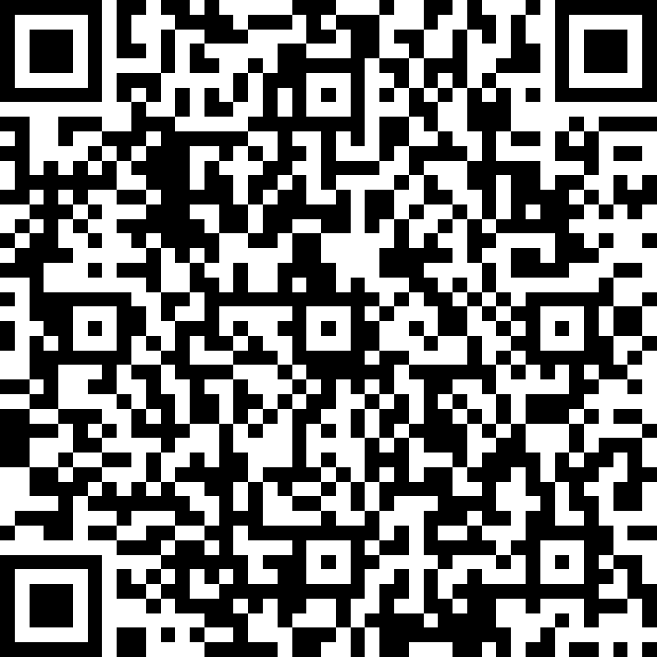
Thank You!
Please complete the our feedback form:
https://forms.office.com/r/pwb0R8s9e5

