Slide 1




Social Prescribing in City and Hackney: lessons from implementation and evaluation
Dr Marcello Bertotti, Senior Research Fellow
University of East London
Dr Patrick Hutt
Clinical Lead
City and Hackney CCG

Slide 2
Overview
Origins of social prescribing in city and Hackney
Video
Evaluation
The Future ….

Slide 3

Origins of social prescribing…
Notes:
Reference the area –
Diverse population.
What were we trying to achieve?

Slide 4

Health Inequalities & Social Gradients
&

Slide 5
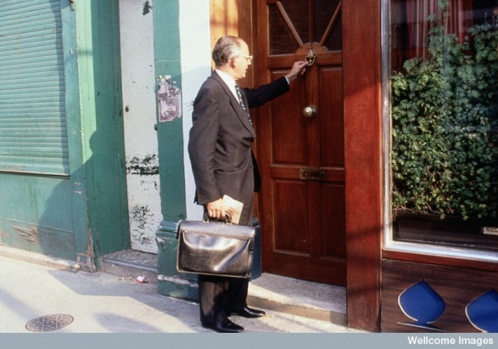
What is the role of General Practice?
Notes:
IDEA THAT THERE IS MORE OUT THERE –
THINKING BROMLEY BY BOW
CHALLENGE WITH OUT WORK FORCE
TURN OVER WITH PROJECTS LOCALLY
INCREASING SOCIAL CAPITAL
CELEBRATING THE DIVERSITY OF LONDON

Slide 6

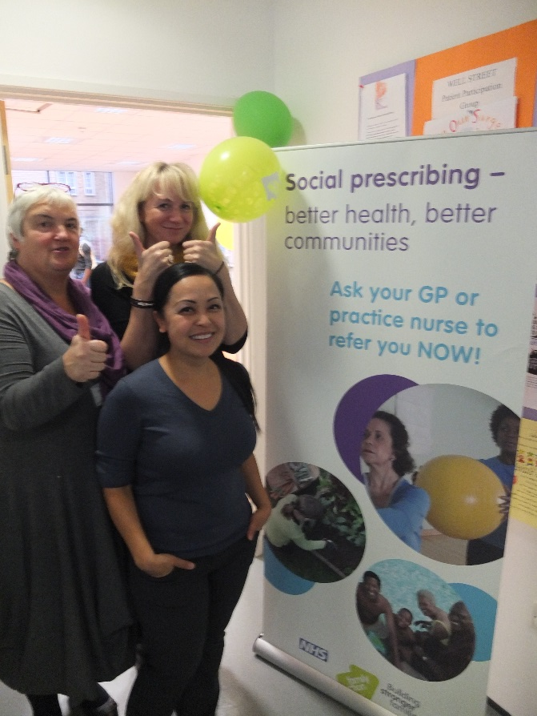
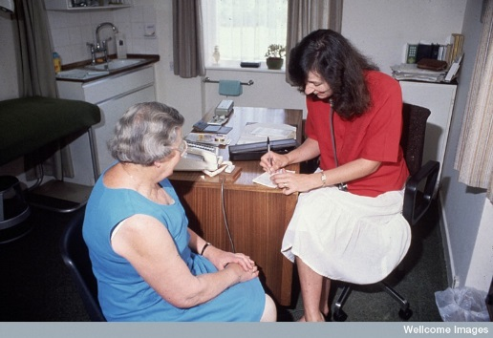
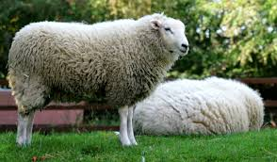
Social Prescribing
City and Hackney CCG
New Age Games
Social Prescribing team facilitating better linking between GPs, patients and community organisations

Slide 7
Implementation
Consultation with community and voluntary organizations
Support from CCG
Shine Innovation funding
Academic partnership working
GP engagement

Slide 8
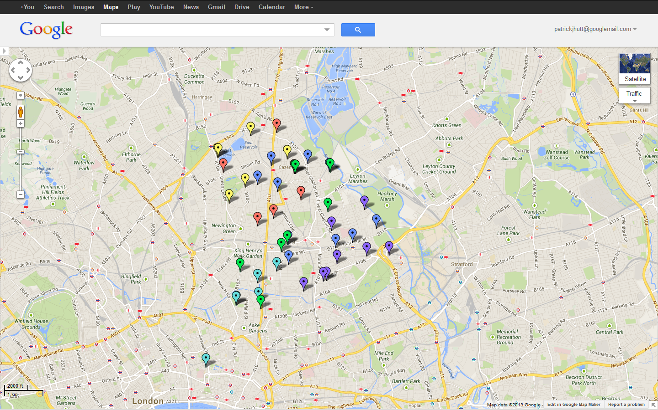
City & Hackney: Three Pilot Consortia
Rainbow and Sunshine Consortium
South West Consortium
Well Consortium
Notes:
DESCRIBE START DATE
MENTION ABOUT THE THROUGHPUT

Slide 9
Referral Criteria
Socially isolated
Frequent attenders to GP/A+E
Presenting with a social problem
Mild-moderate mental health problems
Keen to participate in non-clinical activities but not aware of what’s happening locally

Slide 10
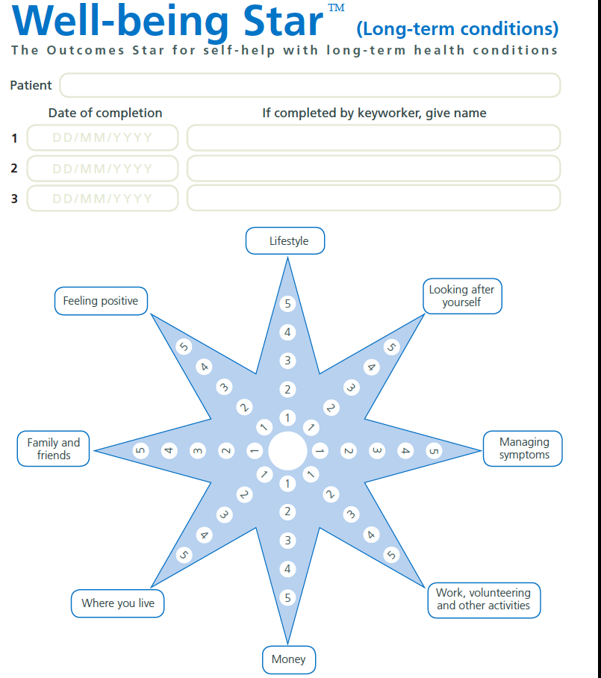
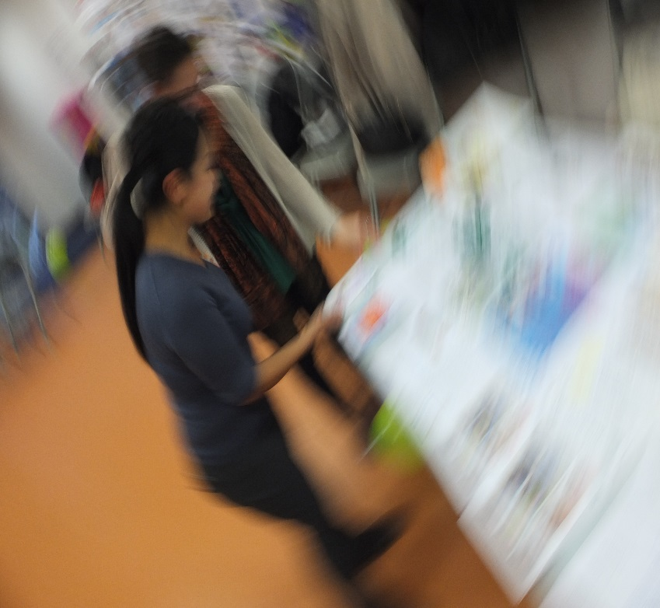
So what happens when you refer?
Assessment Process
Lifestyle
Feeling Positive
Looking after yourself
Family and Friends
Managing symptoms
Where you live
Work, volunteering
Money
Notes:
WELL BEING
11% DNA RATE, 34% 1 CONSULT, 11% MORE THAN FIVE

Slide 11
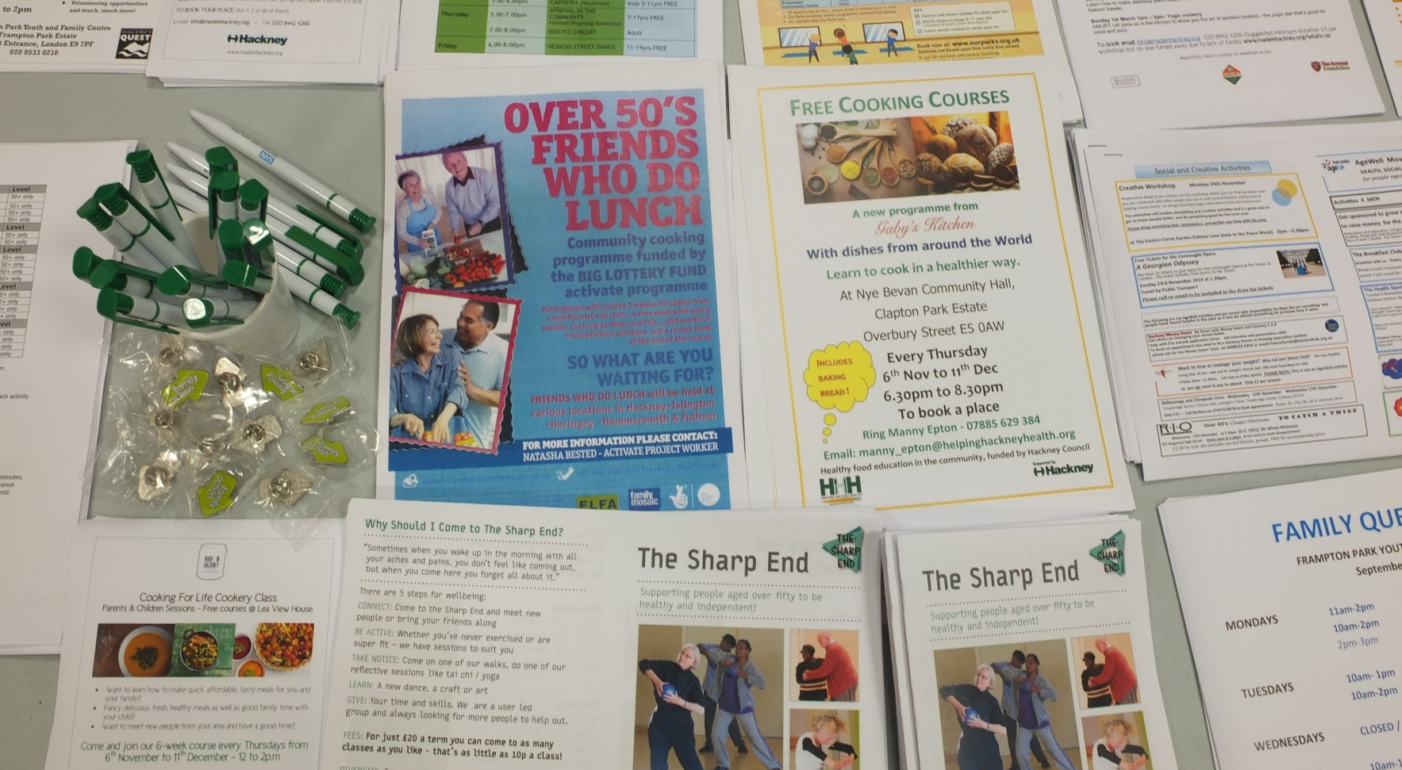
A wide range of options!
Notes:
TAYLOR MADE – USTILISING PUBLIC HEALTH HERO
85 REFERRAL CENTRES

Slide 12
Evaluation
Qualitative
Quantitative
Process evaluation (focus groups with stakeholders)
Two Learning events
Two online GP surveys
Notes:
The evaluation took place between Feb 2014 and July 2015

Slide 13
Qualitative study
In-depth interviews with 15 participants to capture their experience of the intervention
  Some of participants chosen randomly
  Representative in terms of ethnicity, gender, age
  Complex co-morbidities (often mental health with physical health and isolation)

Slide 14
Results from qualitative study
Changes in self-esteem, hope, motivation particularly when sustained through volunteering
“Best thing has been meeting new people and making friends. My mobile full up with names and numbers of friends before it was just family and doctor’s number. I was really depressed before but now really happy. Before I have nothing to do, now every day I wake I think ‘yes volunteer work!’ or ‘meeting friends!’”
Role of social prescriber key to positive changes (from signposting to coaching)
“You feel able to offload if you need to, discuss your fears - it’s about not being so hard on myself and validating myself.”

Slide 15
Prospective cohort study with matched control
184 SP users from 22 GP practices
Baseline
Matched 302 patients from 6 GP practices
8 months Follow up
CHARACTERISTICS OF THE SAMPLE
Age
Gender
Ethnicity
SP users were:
Living alone more
More in non-paid work, fewer employed
Less educated

Slide 16
Baseline data from intervention and control
  We looked at changes in wellbeing, health, anxiety, depression, and social engagement.
  used validated tools including HADS (Hospital Anxiety and Depression Scale), MYMOP (Measure Yourself Medical Outcome Profile), HeIQ (Health Education Impact Questionnaire)
  Group in the intervention had worse health profile than control overall in terms of health, wellbeing, were clinically anxious and depressed and were slightly less socially integrated

Slide 17
Cohort study results at 8 months
Non statistically significant changes in anxiety, depression, health, wellbeing and integration over 8 months
BUT statistically significant reductions in GP consultation rates in comparison to control (one year pre and post referral). However, these are affected by ‘regression to the mean’ which caution about the validity of results.

Slide 18
Conclusion from evaluation
A clear gap between qualitative and quantitative evidence
Further quantitative research is needed with larger samples (only 11% of people at follow up responded), different design and other tools to assess health changes

Slide 19
Video
https://youtu.be/PCxRLAM7wBQ

Slide 20
The Future..
Social Prescribing – rolled out to whole of City and Hackney CCG
Contractual target for GPs as part of the Long Term Condition Local Enhanced Serve
Exploring the possibility of self referral/targeting patients as part of population registers
Funding – 1 more year to run

Slide 21
The Future…
Consider how you demonstrate impact
Make social prescribing coordinators part of the practice team – attending meetings, coffee cup conversations
Patient experience is powerful – strong motivator
What are the successful qualities of the services that SP refers onto?
Opportunity to build social prescribing into any health service configuration

Slide 22
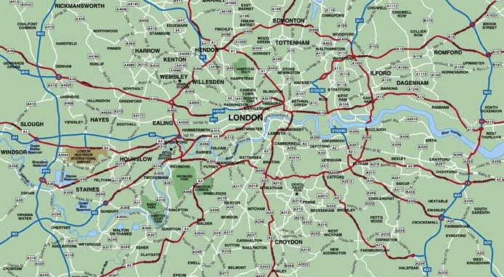
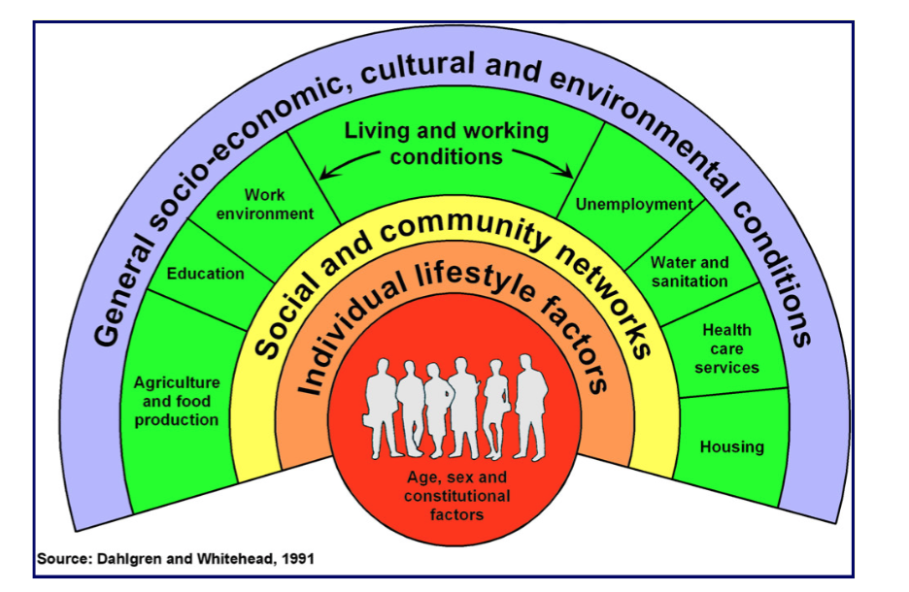

Social Prescribing – great opportunity for partnership working
Notes:
Celebrating the richness of the communities in London

Slide 23
Thank you for listening!

