Slide 1
Counting the cost
of funded early years education and childcare
Presented by Dr Jo Verrill
Managing Director, Ceeda

Slide 2
Our aim
The Pre-school Learning Alliance commissioned the study to answer some fundamental questions
What does it cost to deliver an hour of quality early education and childcare?
How much is paid for this hour of quality early education and childcare?
What is the difference between the delivery cost and funding rate?

Slide 3
The knowledge gap
Can’t translate to hourly cost
Childcare Provider Finance Survey DfE 2012
Can’t evaluate the costing base
NDNA Annual Nursery Survey 2015: 3 & 4 yr old funding gaps

Slide 4
The scope and scale
Our challenge was to address this gap
Establish inputs in a consistent way across settings
Track how resources are deployed
Build the unit cost from the sum of it’s parts
Private voluntary and independent settings on non-domestic premises
Good or outstanding Ofsted
Random stratified sample
100 PVI settings

Slide 5
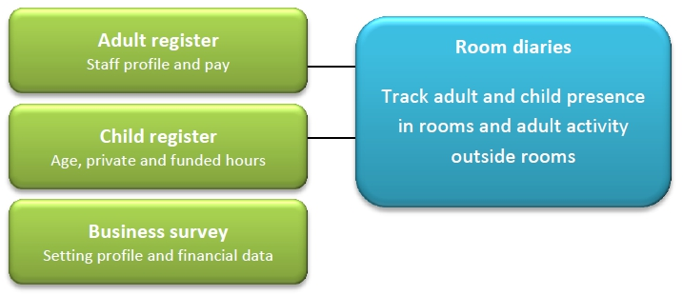
Our approach
Costs tracked across 186,712 hrs of early education used by 5,635 children
3,488 funded 3 and 4 year olds
383 funded 2 year olds
100 PVI settings across 76 LA’s
Notes:
Random sample
Recipe – with consistent ingredients – how they are mixed up – and what it produces in the end. To date, research had lacked one or more of these stages

Slide 6
The detail
Cost calculated for every child at 5 minute intervals averaged across 2 weeks
Broken down into 9 cost elements
Non-labour overhead (premises, utilities, materials etc.)
Supernumerary labour
In-ratio labour
Out of ratio labour (paid & unpaid time separately accounted)
Paperwork
Liaising with parents
Liaising with external agencies
Each child’s average hourly cost then compared with relevant LA delegated PVI funding rate

Slide 7
Funded 2 year olds
Average delegated PVI funding £5.19 per hr
Average delivery cost £5.97 per hr
______
Breakeven funding gap -£0.78 per hr
Average funding gap per child per annum -£407.81
Shortfall of £29.6 million per annum BEFORE expansion to 40% of 2 year olds.

Slide 8
Funded 3 & 4 year olds
Average delegated PVI funding £3.88 per hr
Average delivery cost £4.53 per hr
______
Breakeven funding gap -£0.65 per hr
Average funding gap per child per annum -£347.33
Estimated annual shortfall of £177 million

Slide 9
Understanding costs
Composition of hourly delivery costs for funded 2, 3 and 4 year olds.
383 funded 2 year old children in 73 non-domestic childcare settings
3,488 funded 3 and 4 year old children in 100 non-domestic childcare settings
Excludes unpaid labour

Slide 10
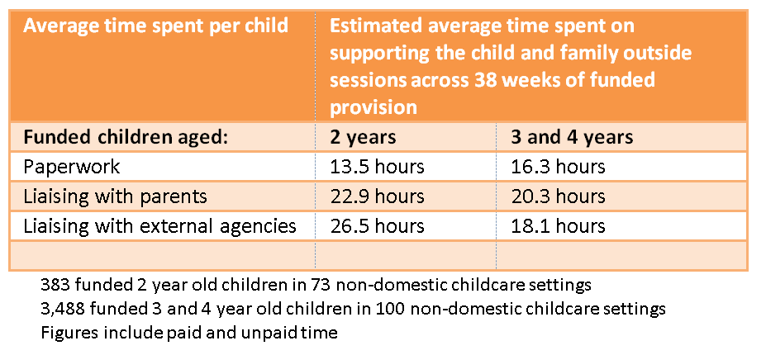
Time spent OUTSIDE sessions
63 hours
55 hours

Slide 11
Occupancy
Delivery costs per hour and occupancy level for funded 2, 3 and 4 year olds
Base:
383 funded 2yr old children in 73 non-domestic childcare settings.
3,488 funded 3 and 4 year old children in 100 non-domestic childcare settings.

Slide 12
Funding mix
Base:
383 funded 2yr old children in 73 non-domestic childcare settings.
3,488 funded 3 and 4 year old children in 100 non-domestic childcare settings.

Slide 13
Direction of travel
Change in LA Funding 2013/14 and 2014/15
Hourly rate delegated to PVI Providers DfE Funding Benchmarking Tool

Slide 14
£ How it stacks up
Funding change 13/14 to 14/15 DfE Funding Benchmarking Tool | 3 to 4 years | 2 years
Minimum | -£1.92 | -£2.04
Maximum | +£0.58 | +£2.02
England average | +£0.03 (0.8%) | -£0.05 (-1%)
The Consumer Prices Index (CPI) grew by 1.6% in the year March 2013 to March 2014
Notes:
Tower Hamlets went from £4.85 to £2.93 for 3 to 4 yr olds = -£1.92
Suffolk went from £3.66 to £4.23 for 3 to 4 yr olds = +0.58
Bury went from £6.94 to £4.90 for funded 2s = -£2.04
Shropshire went from £2.94 to £4.96 funded 2s = +£2.02

Slide 15
2015/16
Early Years Pupil Premium
2 year old funding based on participation
Telford and Wrekin School’s Forum 9th January 2015
“In the context of the frozen level of Early Years DSG and the introduction of the Early Years Pupil Premium it is intended to leave the funding rates for 2015/16 unchanged.”
Devon Education Forum 21st January 2015
“The Early Years funding formula is not sustainable over the longer term. The funding paid out to providers exceeds the level of funding received”
Freezing at £4.95 per hour for 2 year olds in 2015-16, reducing to £4.88 (-1.5%) in 2016-17 and by a further 1.5% in 2017-18 to £4.80
Notes:
Section 251 returns due by 31st March 2015 – not collated for some time
We do know EYPP will be introduced
Funding shifted to participation for 2s with downward trend on funding levels likely to continue
Experience in the room?

Slide 16
Where next?
We have started on the path of understanding delivery costs BUT much more needs to be done
Larger scale to allow local disaggregation
At different points in the year
Across all parts of the sector
DfE recognised the knowledge gaps in a recent consultation on the Schools DSG:
“We are determined to move as quickly as possible to a fully fair allocation of the whole DSG. We cannot do this for 2015-16 because we do not know enough about the genuine cost of high needs and early years provision and how this varies between different areas. DfE Fairer Schools Funding Arrangements for 2015 to 2016. July 2014
Notes:
Recent consultation around reform of Schools funding block of DSG called for reform of all 3 blocks
Research underway to inform High Needs Block
Unclear how Early Years Block will be addressed

Slide 17
In the last 6 months
12 November 2014
A Department for Education spokesperson says the research is:
"totally overblown. It is nonsense to suggest that childcare has been underfunded. The cost of childcare is falling in real terms and we have increased annual funding for early education by over £1bn since 2010.
24th February 2015
“Evidence suggests that the money allocated to free early education policy, and distributed by local authorities, does not cover the economic cost of delivering the free hours in the PVI sector.”
April 13th 2015
“A Conservative government will increase the hourly funding rates paid to providers in different parts of the country, and will consult on the appropriate level and design of the uplift.”

Slide 18
Key messages
Delivery costs are complex and variable
A robust funding model is needed which factors in:
Deprivation and additional needs
Local labour and property markets
Changing qualification requirements
Changes to the minimum wage and pensions
National VAT and local business rate policies
Changes to EYFS e.g. integrated reviews at age 2
Indexed to inflation
A review of early years funding MUST be the first priority before any further expansion

