Slide 1
NAO study findings:
Delivering the free entitlement to education for 3 and 4 year olds
Department for Education VFM Team
April 2012

Slide 2
What is the National Audit Office?
Our role:
To provide independent information, assurance and advice to Parliament on the use of public resources
To help promote better financial management and value for money
Our aim:
We apply the unique perspective of public audit to help Parliament and government drive lasting improvement in public services.

Slide 3
The accountability process
Government requests and Parliament grant funds
Government response
C&AG audits accounts,
examines spending
and reports to Parliament
PAC session and report

Slide 4
Value for money audit (VFM)
Good VFM is the optimal use of resources to achieve the intended outcome
Our reports are used by Parliament to hold government to account for how it spends public money
Our reports highlight important lessons for the body we audit and for government more widely
We don’t comment on the merits of policy but aim to conclude on whether value for money has been secured

Slide 5
Our methodology
The Department’s role: funding, oversight and management of the delivery system
The free entitlement only – not reception classes or the wider early years market inspected by Ofsted
Key methods:
Interviews with the Department, local authorities and other stakeholders
Review of policy documents and academic literature
Census of local authorities
Analysis of data held by the Department and Ofsted

Slide 6
Key facts and figures
£1.9bn
Forecast estimate of spending by local authorities on provision of the free entitlement in 2011-12 (up from £1.6bn in 2010-11)
831,800
Number of 3 and 4 year olds estimated as receiving the free entitlement in January 2011
452m
Hours of free entitlement funded in 2011 (up from 276m in 2003)
28,630
Number of provider settings offering the free entitlement
78%
Providers rated good or outstanding by Ofsted in between September 2008 and March 2011
£3.95
Average rate of local authority funding per entitlement hour in 2010-11
3.5% - 9.8%
Range in the proportion of Dedicated Schools Grant spent on the free entitlement by local authorities in 2010-11
152
Funding formulae (each local authority has its own formula)
59%
Proportion of children who achieved a good level of development at age 5 in 2011
Notes:
Main numbers from report – clarify that this may look different to some published figures eg. 28,630 is our calculation of number of free entitlement providers operating in 2010-11 and 831,800 is our estimate of the number of children receiving the free entitlement rather than free early education, we have taken reception provision out of both figures.

Slide 7
How did we assess value for money?
Whether the Department is achieving value for money in delivering the free entitlement
We assessed whether:
The Department is achieving its objectives for the entitlement
The Department’s funding arrangements support its overall objectives
The Department uses information to understand and improve value for money
Notes:
Brief outline of evaluative criteria and how we set it.
Objectives – vision “for all 3 and 4 year old children to have access to high quality early years provision that helps them reach their full potential”, so we looked at take-up, quality and outcomes (EYFSP and KS1)
Funding arrangements – transparency and efficiency of distribution, incentives to drive market behaviour
Information – to assess effectiveness of delivery and enhance performance and vfm

Slide 8
Achieving objectives
High national take-up rate for early education but lower for disadvantaged children
Children’s development at age five has improved, but results at age seven have not
Quality of providers offering the entitlement sustained since 2008-09
Take-up of the entitlement and access to high quality provision varies depending on where children live
Notes:
High national take-up rate for early education but take-up is lower for disadvantaged children – 95% overall take-up of free early education, although this includes reception. Department’s survey of parents looked at a sample of families and found take-up from the most disadvantaged children to be 9 percentage points lower than their peers.
Children’s development at age five has improved, but results at age seven have not – EYFSP results have risen from 45% (2006) to 59% (2011). KS1 results have shown almost no improvement since 2007 (first cohort to have benefited from the full entitlement would have reached the end of KS1 in 2009).
Quality of providers offering the entitlement sustained since 2008-09 – 78% of providers were rated good or outstanding in 2008-09 and 79% in 2010-11.
Take-up of the entitlement and access to high quality provision varies depending on where children live – take-up varies across local authorities and is lower for disadvantaged children. Quality is lower in more deprived areas.

Slide 9
Quality and area deprivation
% of providers rated good or outstanding by Ofsted (2008-2011)
Level of deprivation
Notes:
Grouped providers according to the level of deprivation in their lower super output area – deprivation measured by Index of Multiple Deprivation (IMD) – to show the proportion of provision rated good or outstanding by Ofsted (between September 2008 and March 2011) according to level of deprivation.
As deprivation increases, the proportion of high quality provision decreases meaning that children in deprived areas are less likely to have access to high quality provision.

Slide 10
Funding arrangements
Local authorities direct different proportions of national funding to the entitlement and funding formulae for local distribution vary significantly
Funding arrangements provide limited incentives for providers to improve quality
Many providers claim that funding does not cover costs of delivering the entitlement.
At least a third of funding formulae are based on limited understanding of provider costs
Notes:
Local authorities direct different proportions of national funding to the entitlement and funding formulae for local distribution vary significantly – next two slides illustrate some of the variations …

Slide 11
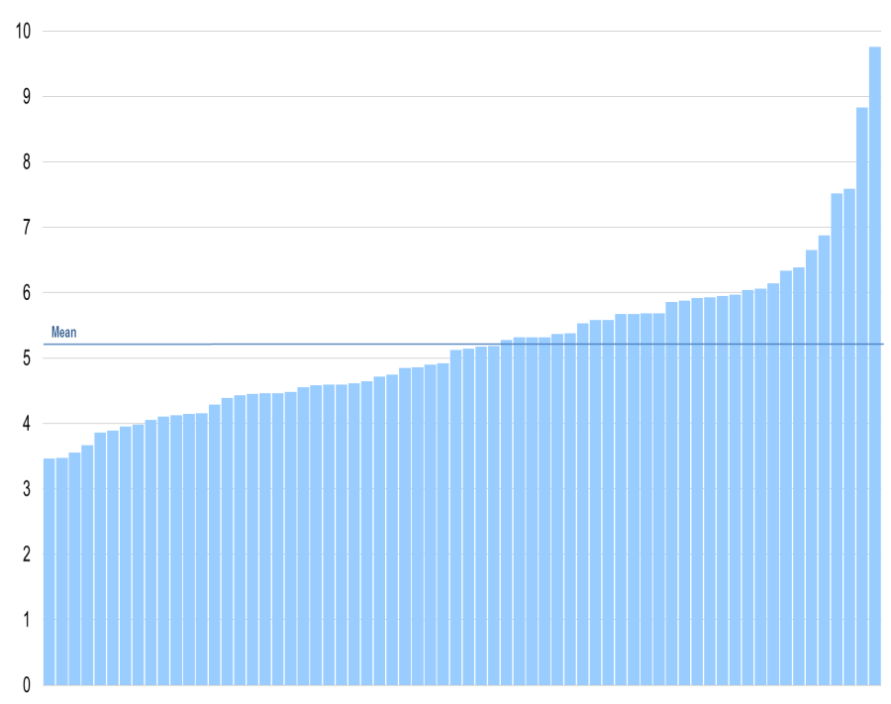
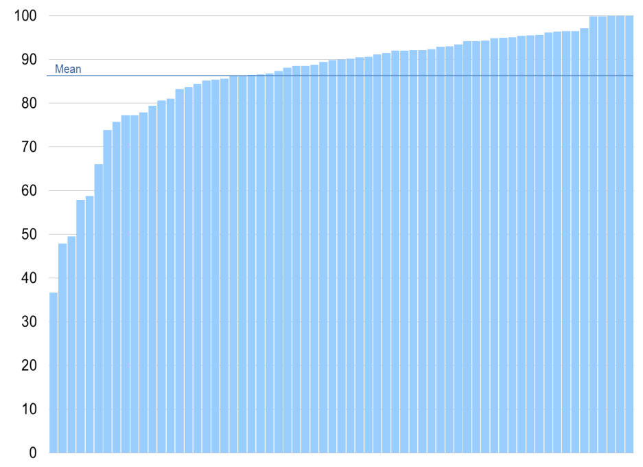
Variations in local authority funding (1)
EYSFF within DSG
Base rates within EYSFF
% of DSG spent through EYSFF in 2010-11
% of EYSFF spent on base rates in 2010-11
Source: NAO analysis of local authority data
Notes:
% of DSG spent on EYSFF (mean = 5.2%) – based on pathfinder local authorities’ s251 returns for 2010-11. Total EYSFF amount as proportion of DSG allocation from DfE.
% of EYSFF distributed through base rates (mean = 86.5%) – based on pathfinder local authorities’ s251 returns for 2010-11. Amount spent on base rates divided by total EYSFF amount. Note: surprising that this range appears to reach 100% as DfE guidance mandates a deprivation supplement.

Slide 12
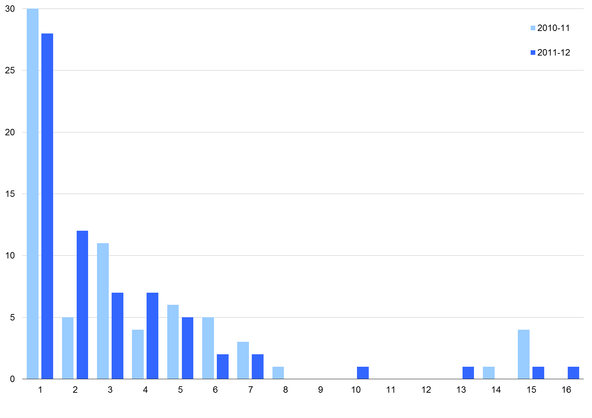
Variations in local authority funding (2)
Number of base rates - pathfinders
Source: NAO analysis of local authority data

Slide 13
Using information to drive value for money
The Department does not yet have robust measures to demonstrate whether longer-term benefits are being realised
Before 2010-11, the Department did not have sufficient data to estimate total spending on the free entitlement
The Department has not tracked what drives performance across providers or authorities
The Department lacks analysis of the relationship between performance and funding levels.
Parental choice drives the market for the entitlement but there are limitations in the information available to parents
Notes:
The Department does not yet have robust measures to demonstrate whether longer-term benefits are being realised
Before 2010-11, the Department did not have sufficient data to estimate total spending on the free entitlement
The Department has not tracked what drives performance across providers or authorities
The Department lacks analysis of the relationship between performance and funding levels.
Parental choice drives the market for the entitlement but there are limitations in the information available to parents

Slide 14
Relationship between funding and quality

Slide 15
Conclusion and recommendations
In delivering the free entitlement to early education, the Department and its partners have made progress against many objectives:
the entitlement has been extended
overall take-up levels have been sustained
children’s development as measured at age five has improved.
However:
a longer-term impact on attainment is not yet visible
the Department and its partners do not yet sufficiently understand the relationship between local performance and funding
if it is to achieve value for money and ensure the best return for its investment of £1.9 billion, the Department needs to address variations in:
take-up,
access to high-quality provision and
the impact on attainment in later years
Recommendations
Use existing information to identify what drives successful performance
Analyse overall performance of local authorities over time, including impact of 90% baseline funding
Identify key data to support local authority benchmarking
Enhance information available to parents
Review information needed to support local authorities to manage their local markets
Simplify local funding formula arrangements
Develop evidence base on long term benefits
Develop measures to judge the return on investment
Notes:
Could use Amyas’ quote from press notice instead:
"The Department for Education needs to do more to put itself in the position to assess whether the forecast long-term benefits of free education for three- and four-year olds are being achieved. It also needs to understand how the arrangements for funding providers of that early education drive its availability, take-up and quality. Both of these are necessary if it is to get the best return for children from the £1.9 billion spent each year."

Slide 16
Market principles
Market principles | Issues raised in NAO report
Are there rules to ensure effective operation of the market? | Department sets the overall funding and delivery framework Local authorities administer funding and delivery arrangements Ofsted enforces delivery of EYFS curriculum
Are users able to make informed choices? | Funding decisions are determined by parents’ choice of provision Parents’ choices driven by factors such as convenience, general well-being of children and cost of additional hours Limitations in the information available to parents
Does the market promote healthy competition? | Local authorities direct different levels of national funding to the entitlement (between 3.5 and 9.8% of DSG allocation) 58% of day nurseries report that funding does not cover the costs of provision (Laing & Buisson) 72% of local authorities estimate that the funding they offer is sufficient to cover costs for ‘all’ or ‘most’ providers
Is the market delivering the public policy objectives? | No robust measures to demonstrate the achievement of long-term objectives Poor quality data limits analysis of variations in performance No robust departmental analysis of the relationship between performance and funding levels Some analysis carried out by local authorities but this is not widespread

Slide 17
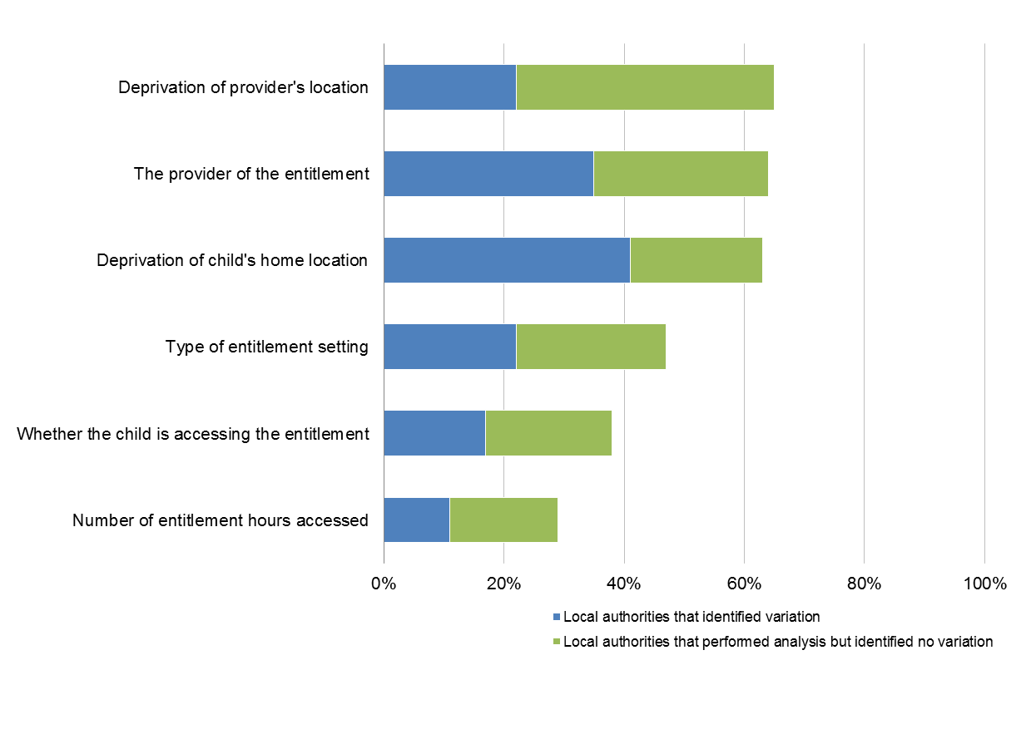
Current use of information by local authorities
Comparisons of performance
Analysis of EYFSP results
Source: NAO survey of local authorities
Notes:
Based on our survey of 152 local authorities (115 responded) – we asked whether local authorities had compared their data with their peers and whether they had performed formal benchmarking exercises across a number of measures. We also asked about whether authorities had analysed the factors causing variation in EYFSP outcomes at age 5.

Slide 18
Questions?

