Slide 1
Profit or Surplus? Implications for Childcare Provider Sustainability
Zoë Raven
ICMEC Seminar November 2012

Slide 2
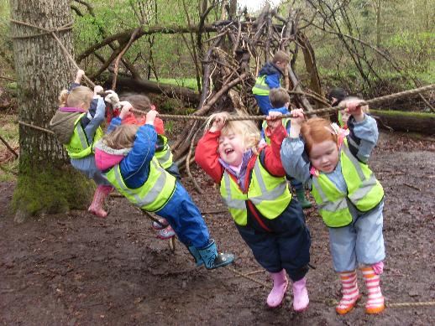
Selfish beginnings
Childcare for my
own children…
Entrepreneurial
beginnings and a
personal motivation
(Having my cake and
eating it: working and
being with my children)

Slide 3
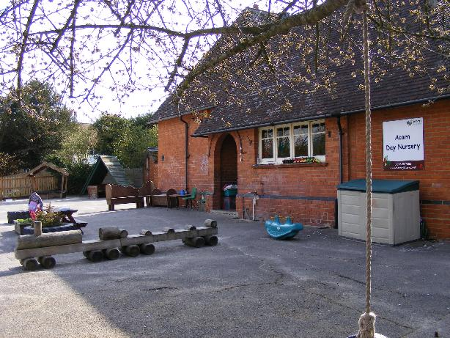
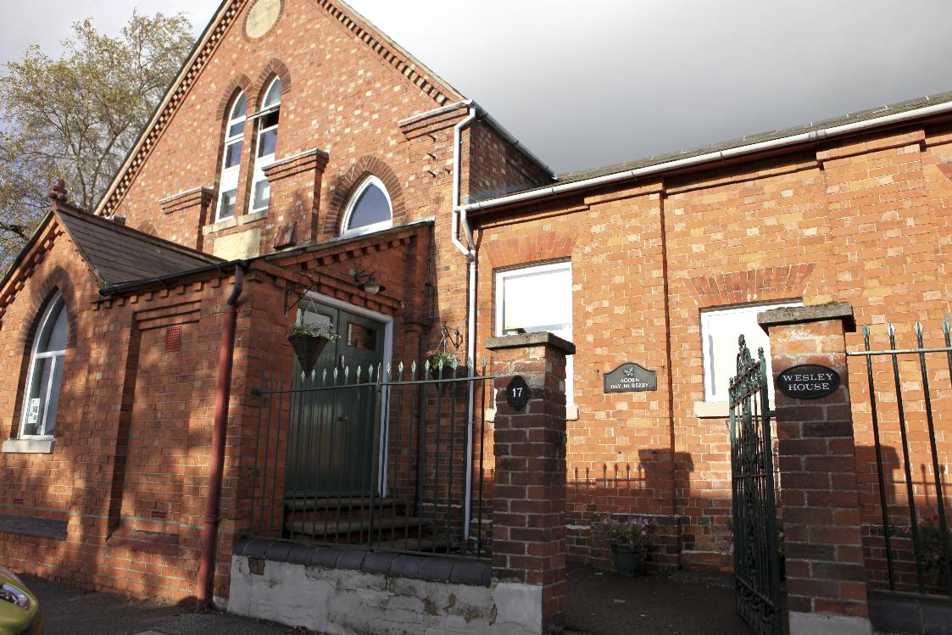
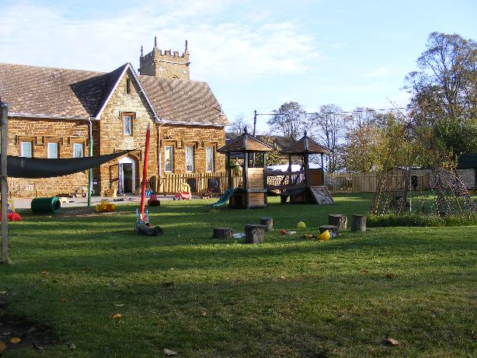
Into the Dragons’ Den

Slide 4
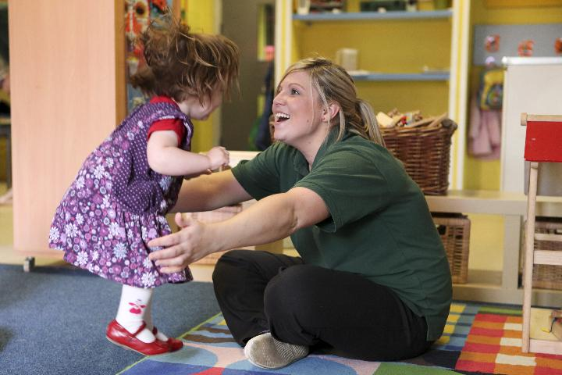
Becoming a business
Change of plan – increasing interest in developing staff team
OU MBA to learn how to make it sustainable

Slide 5
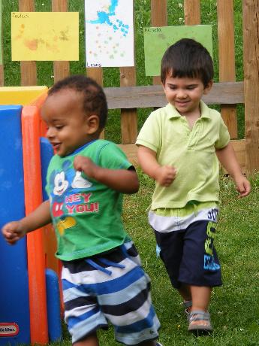
Developing partnerships
2nd stage of growth: tender for new day nursery opportunity at school with NNI funding
Leisure centre partnerships to set up playschemes
Further school based nurseries, including wrap-around care for nursery classes
Not-for-profit or just not profitable?

Slide 6
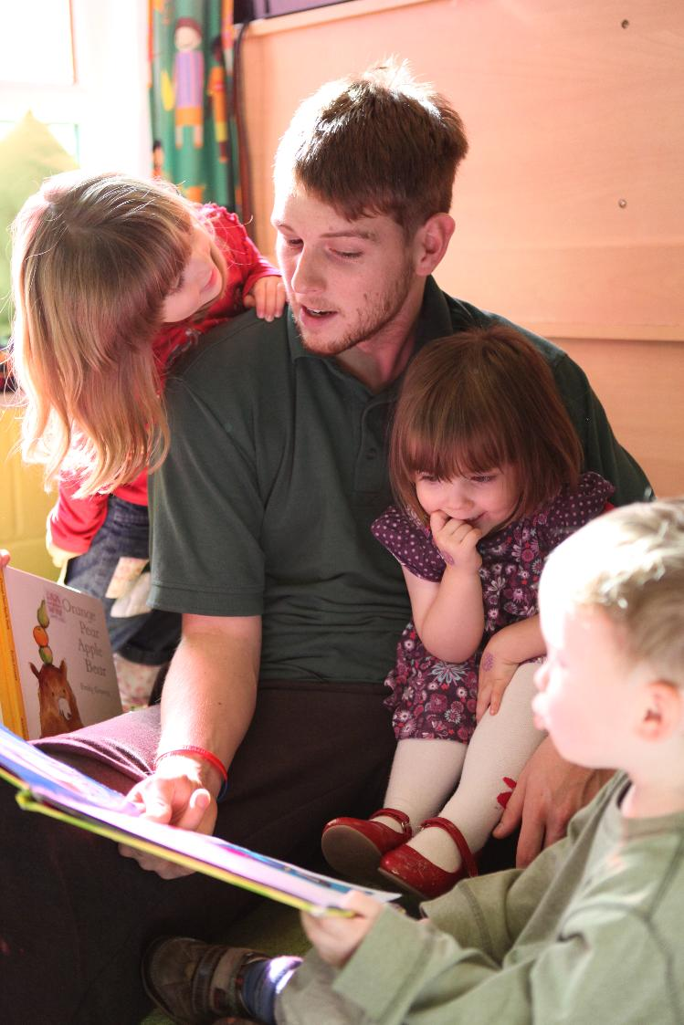
Developing People
MBA confirmed strategy of developing business through developing people
Dissatisfied with training provision, so set up in-house training centre
Growth of business creating more opportunities to promote staff, strategy of ‘growing our own’ managers
Development of central office support team
Forest School training led to creation of full-time forest school roles

Slide 7
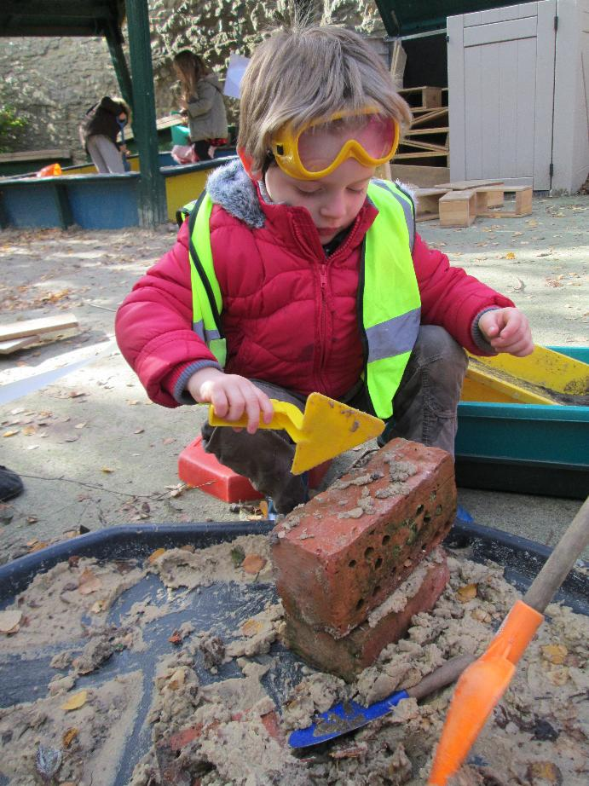
Portfolio strategy
Development of variable fee structure with affluent, profitable nurseries subsidising nurseries in poorer areas
Shortlisted for regional Director of the Year but uncomfortable with IoD support for unethical business practices (tax avoidance, fat cats) and focus on profit

Slide 8
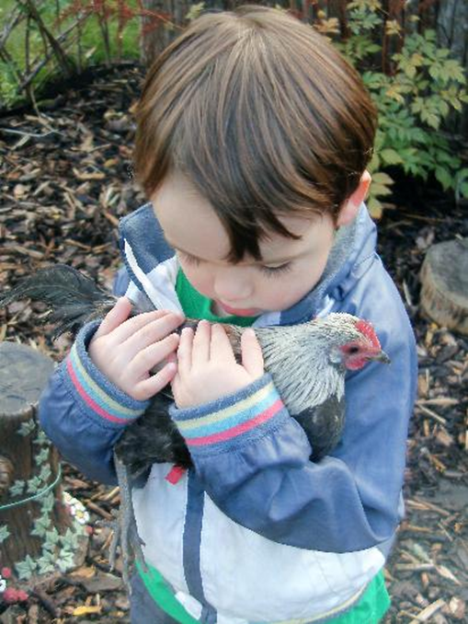
Attitudes…
Local Authority attitudes: ‘private companies must pay commercial rents’ – leading to closure of out-of-school club
Parent attitudes: ‘higher fees mean higher profits’
Rivalry with friendly competitor going down the partnership route

Slide 9
Changes, changes…
Growth of chains of large nurseries: positive impact on quality, but commercial focus
Childcare strategy at last recognising proven impact of professionalising the early years workforce (EPPE study)
Graduate leaders, with funding opportunities to improve quality

Slide 10
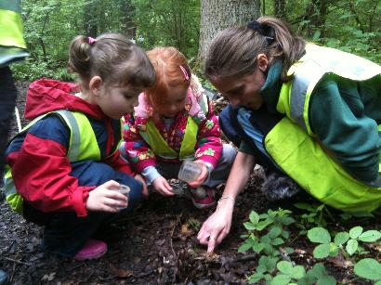
Tall Oaks from Little Acorns
Development of training centre into a separate not-for-profit company
Incorporation of Forest Schools into new company
Notes:
In-house training session with local trainer, discussion at the pub afterwards and opportunity of empty office space at smallholding, creating Tall Oaks, to expand training to external providers, other nurseries and schools.
G&D’s full-time roles – need to develop a Forest School programme that is open to other providers and non-Acorn children to ensure sustainability (and not-for-profit easier to sell to schools)

Slide 11
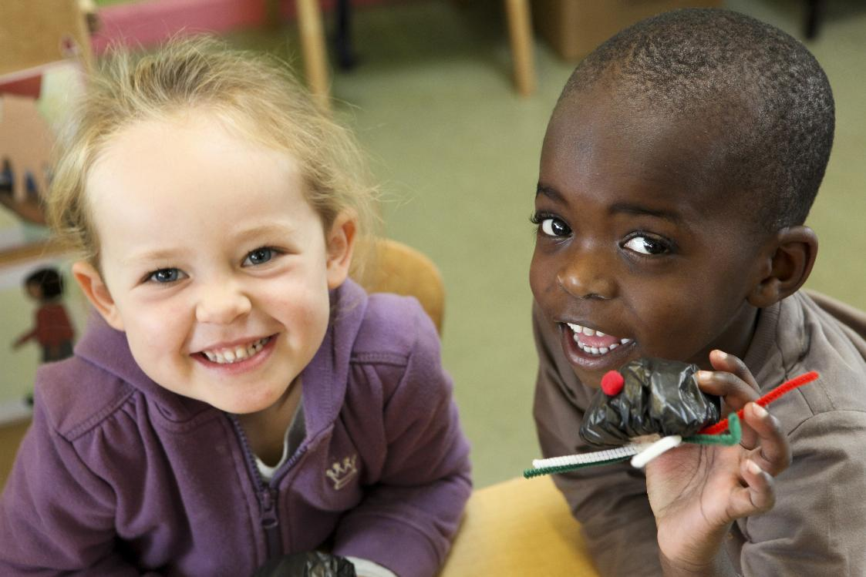
MKC Tender Opportunity
MKC tender for 4 of their loss-making day nurseries
Benefits of being not-for-profit: politically, financially, & for public perception
Notes:
Long-awaited decision by MKC to divest themselves of their nurseries – 4 initially (those not attached to children’s centres)
No-brainer in terms of location, premises, and mature staff teams – though TUPE implications a bit daunting
Leases from charitable MK Community Properties Foundation – better terms for not-for-profit organisations. Campaigning parents also less hostile to not-for-profit organisation.

Slide 12
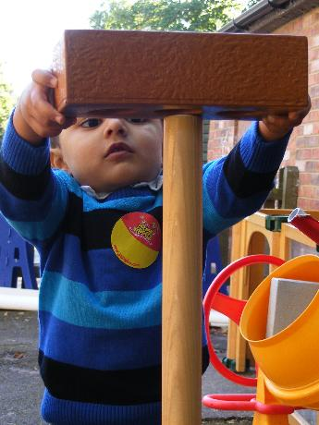
Forming a Charity
Finding trustees
The Charity Commission
Reactions of:
Shareholders
Bank
Stakeholders: parents, staff, schools

Slide 13
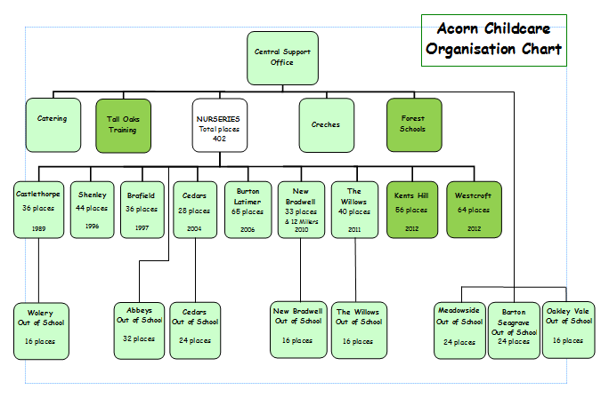
Where we are now…

Slide 14
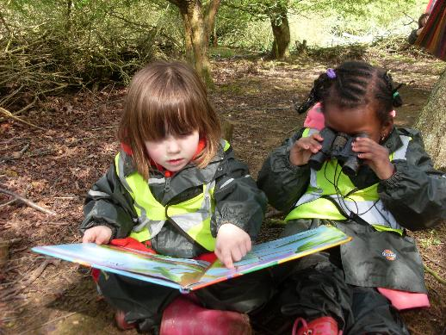
The outlook is bright…
First two Ofsted inspections
IiP re-accreditation
Happy parents and children, mostly happy staff…(if we can resolve some TUPE issues)
Cashflow tight (as usual)

Slide 15
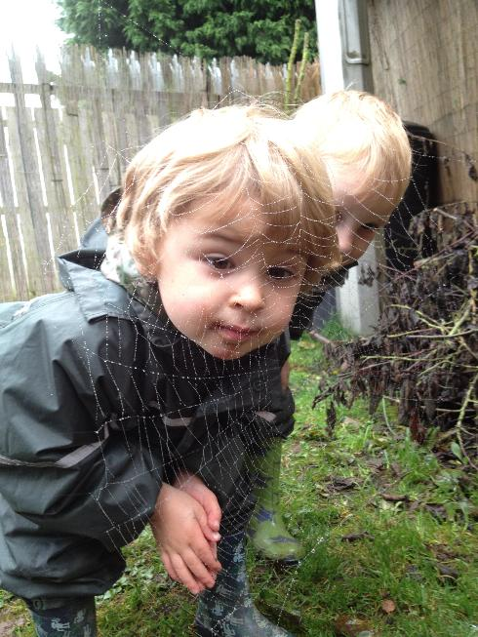
Further information/contact
www.acornchildcare.co.uk
www.talloaks.co.uk
Twitter: @zoeanneraven
Email: zoe@acornchildcare.co.uk
Phone: 07831 653695

