Slide 1
Early Years Education in England – Key Policy Developments November 4th 2014 Patrick Flack Patrick.FLACK@education.gsi.gov.uk

Slide 2
Context – EY in England
Early education entitlement for all three- and four-year-olds of 15 hours/week (570 hours/year). Recently extended to 40% of two-year-olds.
In January 2014, 641,230 three-year-olds (94% of population), and 658,680 four-year-olds (99%) receiving some sort of early education.
That includes a large proportion of four-year-olds that attend school Reception classes.
Objective to provide early education and develop school readiness.
Local authorities purchase places from providers.
Mixed market of provision, reflecting incremental policy growth in this field. 39.1% of three & fours receiving entitlement at PVI providers; 57.7% in maintained primary provision. Different for under-3s.
Early intervention infrastructure around this – particularly Children’s Centres. Funded through local government grant.
Significant state subsidies to parents for childcare costs (not just under-5s) – including through Working Tax Credit and Employer Supported Childcare.
Objective to support parental labour market access and to help cost of living.
Being extended with introduction of Tax Free Childcare in Autumn 2015.

Slide 3
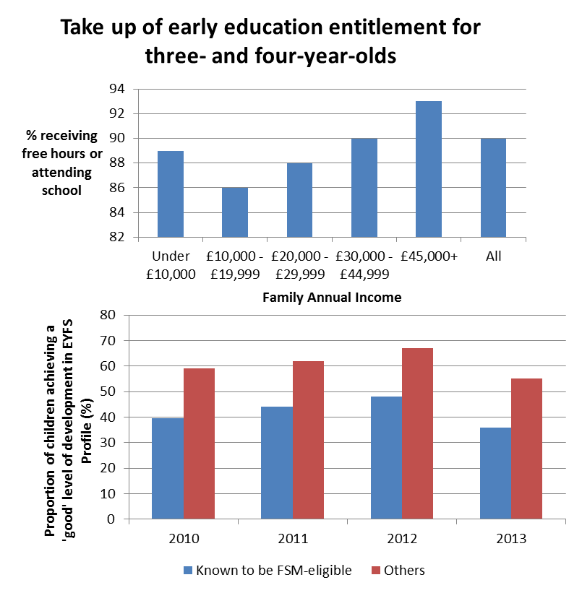
Not all children benefitting…
We know that disadvantaged children can benefit more from good ECEC.
But poorer children less likely to take it up than their peers
Fewer children known to be eligible for FSM achieve a good level of development

Slide 4
What is Government doing?
Supporting improved quality
Supply-side reform to grow the market
Interventions to support early education for disadvantaged children

Slide 5
Improving Quality
Improving qualifications:
Early Years Teachers
Teach First in the Early Years
Apprenticeship Bursary Scheme
Improving inspection:
Ofsted sole arbiter, with consistent quality standards.
Ofsted reforms to the Early Years Inspection Framework
Improving registration:
introducing a single, clear set of safeguarding and welfare requirements.
Improving home learning environment:
For example, promoting “Five to Thrive” campaign

Slide 6
Supply-side reform
Improving consistency of who can offer the entitlement, by making Ofsted the sole arbiter of quality.
Introducing Childminder Agencies from September 2014. These will make it simpler for people to become childminders, provide training and support.
Making it easier for schools to open nurseries: Enabling schools automatically to accept two-year-olds as well as three-year-olds. Actively encouraging primary schools to open for longer.
Simplifying planning rules so that nurseries can expand more easily.

Slide 7
Focus on Disadvantage (1)
Early education entitlement for disadvantaged two-year-olds.
Extends the 15 hour entitlement to 40% least advantage two-year-olds.
Steadily improving take-up since introduced. Waiting for figures
Ambition to deliver entirely through ‘good’ or ‘outstanding’ settings.

Slide 8
Focus on Disadvantage (2)
Early years pupil premium will be introduced in April 2015.
Extends model successfully used in schools since 2011: money follows the child and providers have flexibility in how to make best use of the funding.
Expect providers to use it to improve quality of provision for disadvantaged children – e.g. by investing in workforce.
Providers will be held to account for effective use of this by Ofsted, through the inspection framework.

Slide 9
Any questions?

